Slide 1
User Centered Design
What is User-Centered Design(UCD)
User-centered design (UCD) is an iterative design process in which designers focus on the users and their needs in each phase of the design process.
In UCD, design teams involve users throughout the design process via a variety of research and design techniques, to create highly usable and accessible products for them.
Note: Focus is on gaining a deeper understanding of who will be using the product.
Notes:
https://www.interaction-design.org/literature/topics/user-centered-design
So let's break this down into some pieces, some key phrases here, focusing on gaining a deeper understanding
of who will be using the product.
So it's trying to get into the mindset of the people, the humans who will be interacting with your
product system or service.
That's the whole point of being user centric, user centered design and trying to design the experience,
the interface, the processes, the workflows, the tasks that they will be trying to perform while
using your product system or service from their perspective to help them be successful while using your
product system or service.

Slide 2
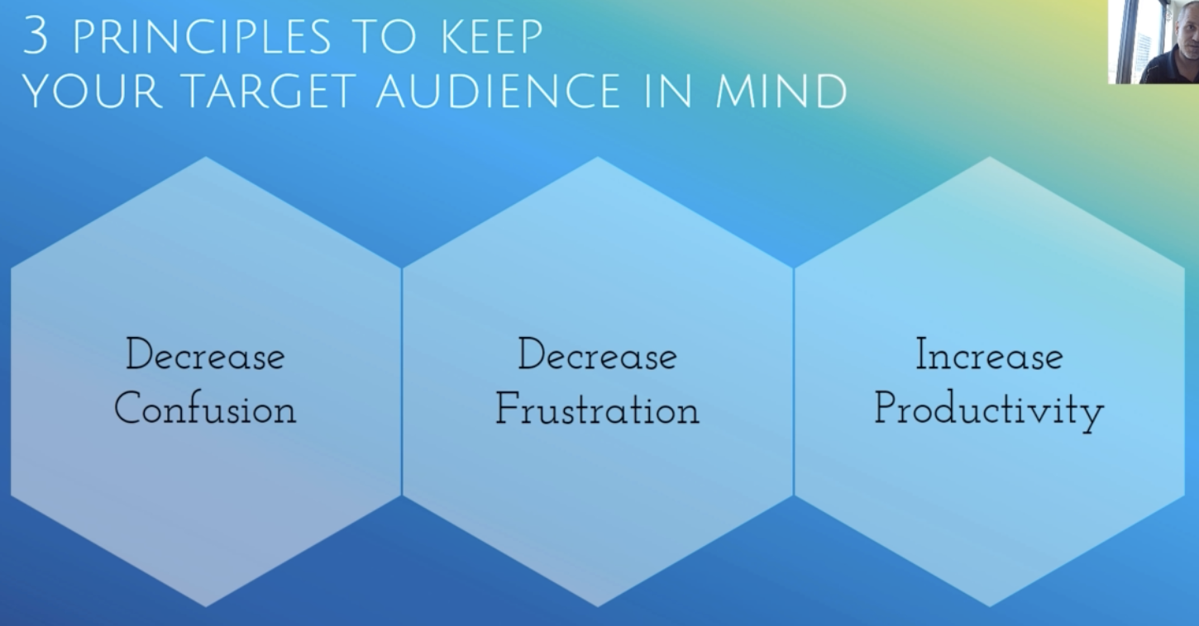
User Centered Design
UCD is an iterative process
UCD is an Iterative Process
In user-centered design, designers use a mixture of investigative methods and tools (e.g., surveys and interviews) and generative ones (e.g., brainstorming) to develop an understanding of user needs.
Notes:
https://www.interaction-design.org/literature/topics/user-centered-design

Slide 3
User Experience (UX)
User experience is a person's perceptions and responses that result from the use or anticipated use of a product system or service.
The field of user experience centers on the idea that we must design products around people, rather than teaching people how to use products: user-centered design (UCD), not technology-centered design.
In order to do so, we must understand people—their behaviors, attitudes, needs, and goals.
Notes:
a person's perceptions and responses that result from the use or anticipated use of a product system
or service.
That's a lot.
So let's break this one down into pieces, too.
So it's a pursuit, a person's perceptions and responses of their anticipated use.
It's before they even use your product system or service.
You might be scratching your head, perhaps what they read about it in the marketing material, what
someone else has told them about it, how they first became exposed to know that your product system
or service even exists.
That's the anticipated use.
What is that mindset?
Those perceptions and responses that they have as they're sitting down before they've even started to
use your product system or service?
Have they heard that your product system or service is easy to use its user friendly?
It's a delightful experience.
Or perhaps have they heard that?
It just seems clunky, it's cumbersome, it's difficult to use.
It's confusing, it's frustrating.
That's all part of the user experience, these preconceived notions that they bring with them when they
sit down to use your product system or service.
And of course, it's while they're actually using your product.
As they go through interacting with your product, is it responding in a way that they would expect?
Is it useful to them?
Is it usable?
Is it delightful?
Do they enjoy using it?
Do they look forward to using it again?
Would they tell other people that it's fantastic.
I enjoyed using this.
It was helpful for me.
It helped me achieve some tasks and that they should suggest other people to use it as well.
So it's both that preconceived notion before they even start to use your product, kind of that referral
of the people telling them about it, what they've read from their marketing materials.
And of course, while they're actually using a product system or service.
I like to break it down into three simple pieces.
I've kind of already mentioned some of these words first.
Is it useful?
Does it help them achieve something?
Does it help them accomplish some tasks, some workflows that they can provide information and they
can get some results back?
Is it useful to them?
Second, is it usable?
Is it user friendly?
It's sort of from the inverse.
It avoids points of confusion, points of frustration.
They're able to understand your interface.
There's an easy learning curve to understand kind of the cadence of how your system works, where things
typically are located in the interface.
When they interact with something, it gives them an anticipated results or interaction back.
That's kind of more from the usable perspective.
And third.
Is it delightful?
Does it put a smile on their face?
Even systems I've worked on that were for very complex enterprise systems, processing millions of data
records in the utility industry or even in the medical industry.
It can still put a smile on someone's face that it helped them achieve their job.
It was efficient, it was effective.
It even put a smile and that they looked forward to using your your product system or service.
Once again, the delight factor.
So this was just a quick look at some of the definitions for user centered design and user experience.

Slide 4
User Experience (UX)
A good UX depends on the following points:
How does a person feel when using the product?
How accessible is it for the person to navigate the product? Can everyone use it?
How usable is the product? Does it work as intended?
How easy is it for the person to navigate and find the necessary information?
How well-planned and intuitive are the steps a user needs to take to accomplish a task?
How logical is the sequence of actions a user needs to perform to accomplish their goal with ease?
Does it make it easy for them to achieve their initial goal?
How well structured is the content available? Does it follow a logical hierarchy?
How useful is the product?
How valuable is the product?
Does it serve a purpose?
Notes:
a person's perceptions and responses that result from the use or anticipated use of a product system
or service.
That's a lot.
So let's break this one down into pieces, too.
So it's a pursuit, a person's perceptions and responses of their anticipated use.
It's before they even use your product system or service.
You might be scratching your head, perhaps what they read about it in the marketing material, what
someone else has told them about it, how they first became exposed to know that your product system
or service even exists.
That's the anticipated use.
What is that mindset?
Those perceptions and responses that they have as they're sitting down before they've even started to
use your product system or service?
Have they heard that your product system or service is easy to use its user friendly?
It's a delightful experience.
Or perhaps have they heard that?
It just seems clunky, it's cumbersome, it's difficult to use.
It's confusing, it's frustrating.
That's all part of the user experience, these preconceived notions that they bring with them when they
sit down to use your product system or service.
And of course, it's while they're actually using your product.
As they go through interacting with your product, is it responding in a way that they would expect?
Is it useful to them?
Is it usable?
Is it delightful?
Do they enjoy using it?
Do they look forward to using it again?
Would they tell other people that it's fantastic.
I enjoyed using this.
It was helpful for me.
It helped me achieve some tasks and that they should suggest other people to use it as well.
So it's both that preconceived notion before they even start to use your product, kind of that referral
of the people telling them about it, what they've read from their marketing materials.
And of course, while they're actually using a product system or service.
I like to break it down into three simple pieces.
I've kind of already mentioned some of these words first.
Is it useful?
Does it help them achieve something?
Does it help them accomplish some tasks, some workflows that they can provide information and they
can get some results back?
Is it useful to them?
Second, is it usable?
Is it user friendly?
It's sort of from the inverse.
It avoids points of confusion, points of frustration.
They're able to understand your interface.
There's an easy learning curve to understand kind of the cadence of how your system works, where things
typically are located in the interface.
When they interact with something, it gives them an anticipated results or interaction back.
That's kind of more from the usable perspective.
And third.
Is it delightful?
Does it put a smile on their face?
Even systems I've worked on that were for very complex enterprise systems, processing millions of data
records in the utility industry or even in the medical industry.
It can still put a smile on someone's face that it helped them achieve their job.
It was efficient, it was effective.
It even put a smile and that they looked forward to using your your product system or service.
Once again, the delight factor.
So this was just a quick look at some of the definitions for user centered design and user experience.

Slide 5
Design Thinking
Design thinking is a methodology which provides a solution-based approach to solving problems.
It’s extremely useful when used to tackle complex problems that are ill-defined or unknown—because it serves to understand the human needs involved, reframe the problem in human-centric ways, create numerous ideas in brainstorming sessions and adopt a hands-on approach to prototyping and testing.
Notes:
https://www.interaction-design.org/literature/article/5-stages-in-the-design-thinking-process
a person's perceptions and responses that result from the use or anticipated use of a product system
or service.
That's a lot.
So let's break this one down into pieces, too.
So it's a pursuit, a person's perceptions and responses of their anticipated use.
It's before they even use your product system or service.
You might be scratching your head, perhaps what they read about it in the marketing material, what
someone else has told them about it, how they first became exposed to know that your product system
or service even exists.
That's the anticipated use.
What is that mindset?
Those perceptions and responses that they have as they're sitting down before they've even started to
use your product system or service?
Have they heard that your product system or service is easy to use its user friendly?
It's a delightful experience.
Or perhaps have they heard that?
It just seems clunky, it's cumbersome, it's difficult to use.
It's confusing, it's frustrating.
That's all part of the user experience, these preconceived notions that they bring with them when they
sit down to use your product system or service.
And of course, it's while they're actually using your product.
As they go through interacting with your product, is it responding in a way that they would expect?
Is it useful to them?
Is it usable?
Is it delightful?
Do they enjoy using it?
Do they look forward to using it again?
Would they tell other people that it's fantastic.
I enjoyed using this.
It was helpful for me.
It helped me achieve some tasks and that they should suggest other people to use it as well.
So it's both that preconceived notion before they even start to use your product, kind of that referral
of the people telling them about it, what they've read from their marketing materials.
And of course, while they're actually using a product system or service.
I like to break it down into three simple pieces.
I've kind of already mentioned some of these words first.
Is it useful?
Does it help them achieve something?
Does it help them accomplish some tasks, some workflows that they can provide information and they
can get some results back?
Is it useful to them?
Second, is it usable?
Is it user friendly?
It's sort of from the inverse.
It avoids points of confusion, points of frustration.
They're able to understand your interface.
There's an easy learning curve to understand kind of the cadence of how your system works, where things
typically are located in the interface.
When they interact with something, it gives them an anticipated results or interaction back.
That's kind of more from the usable perspective.
And third.
Is it delightful?
Does it put a smile on their face?
Even systems I've worked on that were for very complex enterprise systems, processing millions of data
records in the utility industry or even in the medical industry.
It can still put a smile on someone's face that it helped them achieve their job.
It was efficient, it was effective.
It even put a smile and that they looked forward to using your your product system or service.
Once again, the delight factor.
So this was just a quick look at some of the definitions for user centered design and user experience.

Slide 6
Design Thinking
Design thinking is an iterative, non-linear process which focuses on a collaboration between designers and users. It brings innovative solutions to life based on how real users think, feel and behave.
This human-centered design process consists of five core stages Empathize, Define, Ideate, Prototype and Test.
It’s important to note that these stages are a guide. The iterative, non-linear nature of design thinking means you and your design team can carry these stages out simultaneously, repeat them and even circle back to previous stages at any point in the design thinking process.
Notes:
https://www.interaction-design.org/literature/article/5-stages-in-the-design-thinking-process
Design thinking is a non-linear, iterative process that can have anywhere from three to seven phases, depending on whom you talk to.
Lets focus on the five-stage design thinking model proposed by the Hasso Plattner Institute of Design at Stanford (the d.school) because they are world-renowned for the way they teach and apply design thinking.
The five stages of design thinking, according to the d.school, are:
Empathize: research your users' needs.
Define: state your users' needs and problems.
Ideate: challenge assumptions and create ideas.
Prototype: start to create solutions.
Test: try your solutions out.
Design thinking is a non-linear, iterative process that can have anywhere from three to seven phases, depending on whom you talk to.
Lets focus on the five-stage design thinking model proposed by the Hasso Plattner Institute of Design at Stanford (the d.school) because they are world-renowned for the way they teach and apply design thinking.
The five stages of design thinking, according to the d.school, are:
Empathize: research your users' needs.
Define: state your users' needs and problems.
Ideate: challenge assumptions and create ideas.
Prototype: start to create solutions.
Test: try your solutions out.
a person's perceptions and responses that result from the use or anticipated use of a product system
or service.
That's a lot.
So let's break this one down into pieces, too.
So it's a pursuit, a person's perceptions and responses of their anticipated use.
It's before they even use your product system or service.
You might be scratching your head, perhaps what they read about it in the marketing material, what
someone else has told them about it, how they first became exposed to know that your product system
or service even exists.
That's the anticipated use.
What is that mindset?
Those perceptions and responses that they have as they're sitting down before they've even started to
use your product system or service?
Have they heard that your product system or service is easy to use its user friendly?
It's a delightful experience.
Or perhaps have they heard that?
It just seems clunky, it's cumbersome, it's difficult to use.
It's confusing, it's frustrating.
That's all part of the user experience, these preconceived notions that they bring with them when they
sit down to use your product system or service.
And of course, it's while they're actually using your product.
As they go through interacting with your product, is it responding in a way that they would expect?
Is it useful to them?
Is it usable?
Is it delightful?
Do they enjoy using it?
Do they look forward to using it again?
Would they tell other people that it's fantastic.
I enjoyed using this.
It was helpful for me.
It helped me achieve some tasks and that they should suggest other people to use it as well.
So it's both that preconceived notion before they even start to use your product, kind of that referral
of the people telling them about it, what they've read from their marketing materials.
And of course, while they're actually using a product system or service.
I like to break it down into three simple pieces.
I've kind of already mentioned some of these words first.
Is it useful?
Does it help them achieve something?
Does it help them accomplish some tasks, some workflows that they can provide information and they
can get some results back?
Is it useful to them?
Second, is it usable?
Is it user friendly?
It's sort of from the inverse.
It avoids points of confusion, points of frustration.
They're able to understand your interface.
There's an easy learning curve to understand kind of the cadence of how your system works, where things
typically are located in the interface.
When they interact with something, it gives them an anticipated results or interaction back.
That's kind of more from the usable perspective.
And third.
Is it delightful?
Does it put a smile on their face?
Even systems I've worked on that were for very complex enterprise systems, processing millions of data
records in the utility industry or even in the medical industry.
It can still put a smile on someone's face that it helped them achieve their job.
It was efficient, it was effective.
It even put a smile and that they looked forward to using your your product system or service.
Once again, the delight factor.
So this was just a quick look at some of the definitions for user centered design and user experience.

Slide 7
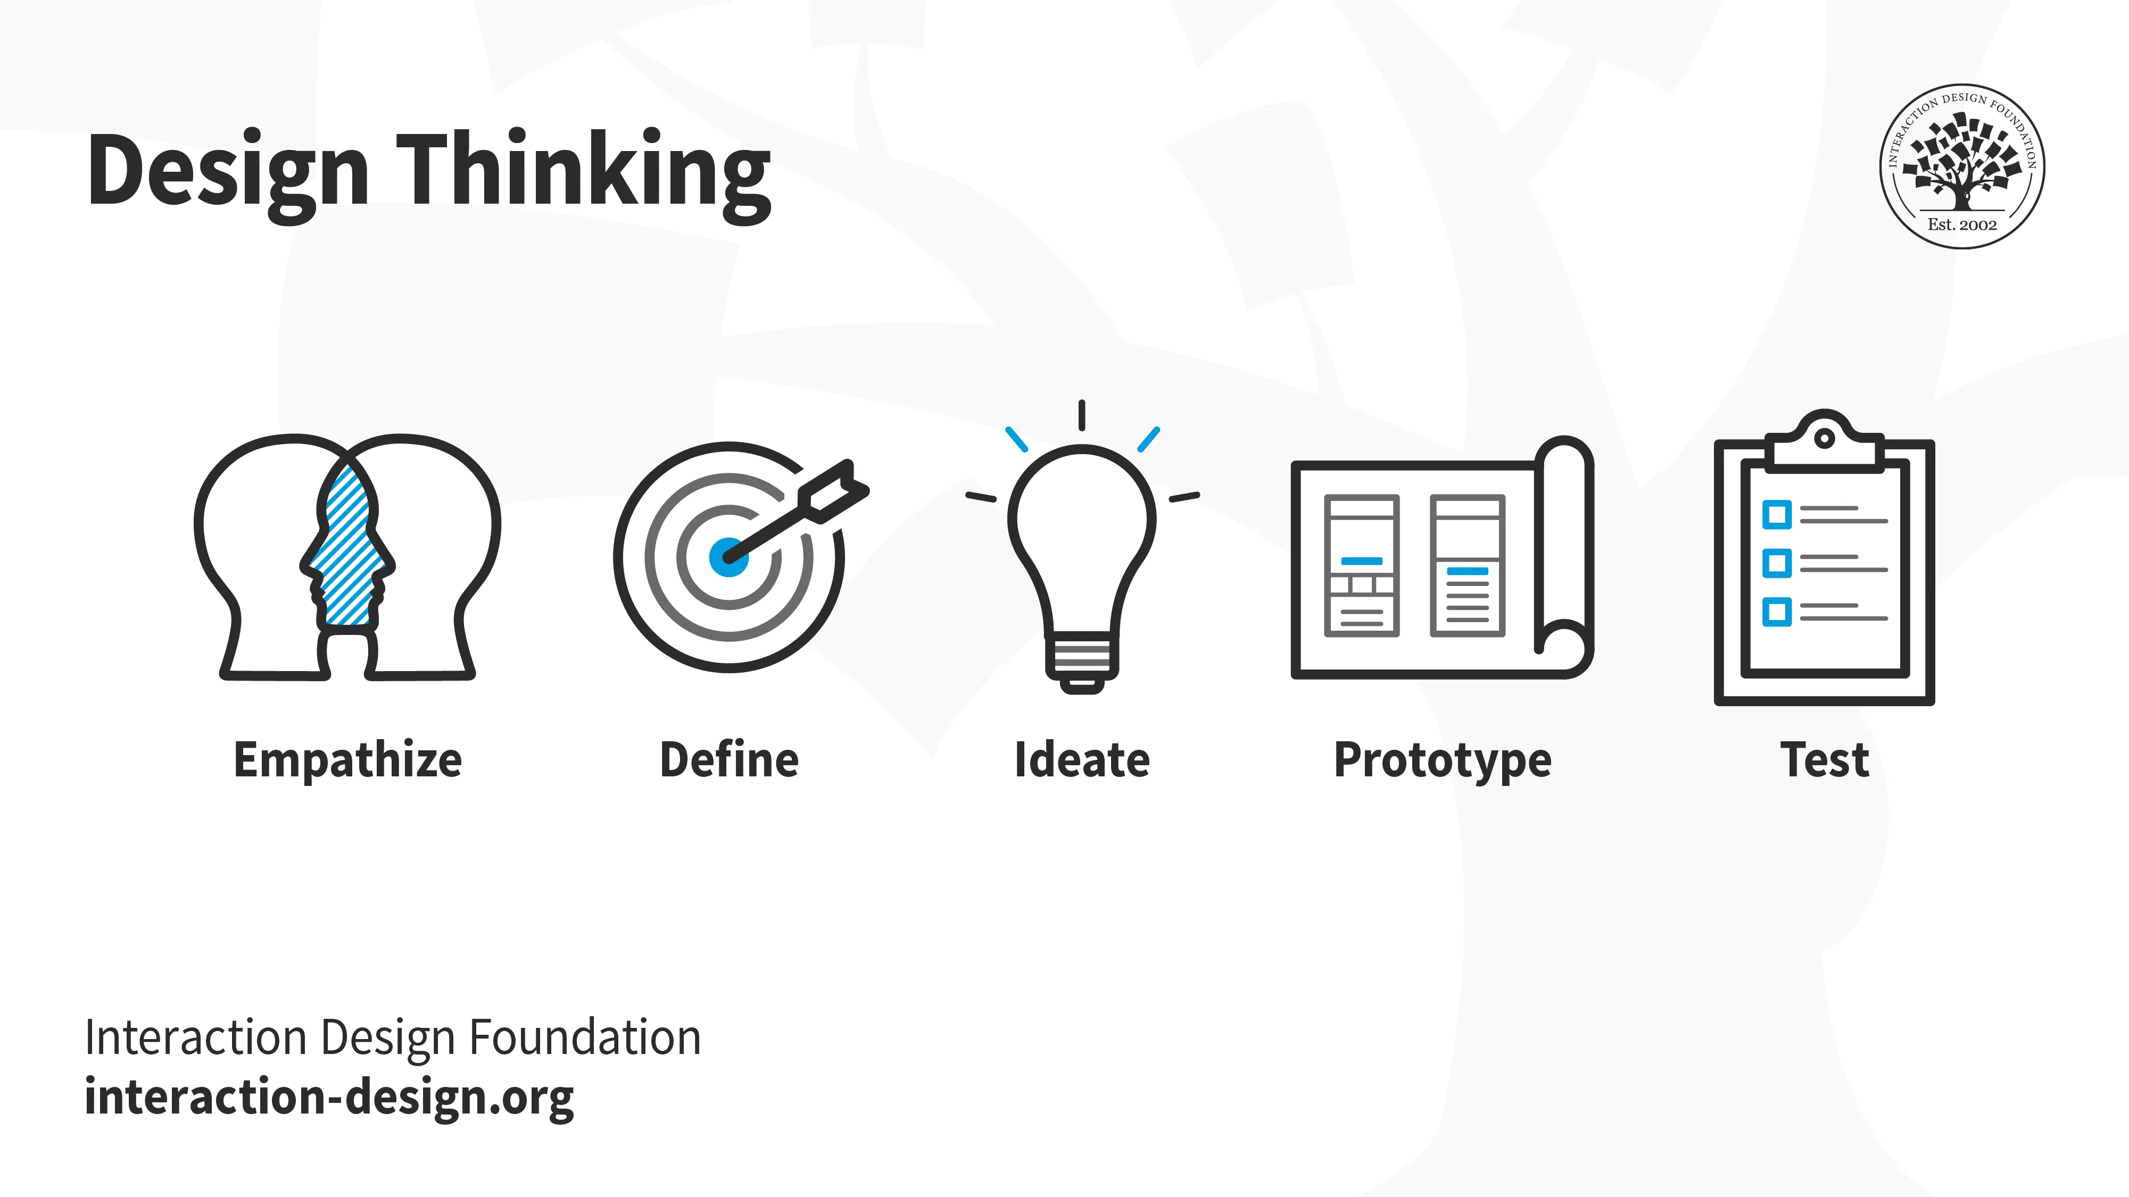
Design Thinking
Notes:
https://www.interaction-design.org/literature/article/5-stages-in-the-design-thinking-process
Design thinking is a non-linear, iterative process that can have anywhere from three to seven phases, depending on whom you talk to.
Lets focus on the five-stage design thinking model proposed by the Hasso Plattner Institute of Design at Stanford (the d.school) because they are world-renowned for the way they teach and apply design thinking.
The five stages of design thinking, according to the d.school, are:
Empathize: research your users' needs.
Define: state your users' needs and problems.
Ideate: challenge assumptions and create ideas.
Prototype: start to create solutions.
Test: try your solutions out.
Design thinking is a non-linear, iterative process that can have anywhere from three to seven phases, depending on whom you talk to.
Lets focus on the five-stage design thinking model proposed by the Hasso Plattner Institute of Design at Stanford (the d.school) because they are world-renowned for the way they teach and apply design thinking.
The five stages of design thinking, according to the d.school, are:
Empathize: research your users' needs.
Define: state your users' needs and problems.
Ideate: challenge assumptions and create ideas.
Prototype: start to create solutions.
Test: try your solutions out.
a person's perceptions and responses that result from the use or anticipated use of a product system
or service.
That's a lot.
So let's break this one down into pieces, too.
So it's a pursuit, a person's perceptions and responses of their anticipated use.
It's before they even use your product system or service.
You might be scratching your head, perhaps what they read about it in the marketing material, what
someone else has told them about it, how they first became exposed to know that your product system
or service even exists.
That's the anticipated use.
What is that mindset?
Those perceptions and responses that they have as they're sitting down before they've even started to
use your product system or service?
Have they heard that your product system or service is easy to use its user friendly?
It's a delightful experience.
Or perhaps have they heard that?
It just seems clunky, it's cumbersome, it's difficult to use.
It's confusing, it's frustrating.
That's all part of the user experience, these preconceived notions that they bring with them when they
sit down to use your product system or service.
And of course, it's while they're actually using your product.
As they go through interacting with your product, is it responding in a way that they would expect?
Is it useful to them?
Is it usable?
Is it delightful?
Do they enjoy using it?
Do they look forward to using it again?
Would they tell other people that it's fantastic.
I enjoyed using this.
It was helpful for me.
It helped me achieve some tasks and that they should suggest other people to use it as well.
So it's both that preconceived notion before they even start to use your product, kind of that referral
of the people telling them about it, what they've read from their marketing materials.
And of course, while they're actually using a product system or service.
I like to break it down into three simple pieces.
I've kind of already mentioned some of these words first.
Is it useful?
Does it help them achieve something?
Does it help them accomplish some tasks, some workflows that they can provide information and they
can get some results back?
Is it useful to them?
Second, is it usable?
Is it user friendly?
It's sort of from the inverse.
It avoids points of confusion, points of frustration.
They're able to understand your interface.
There's an easy learning curve to understand kind of the cadence of how your system works, where things
typically are located in the interface.
When they interact with something, it gives them an anticipated results or interaction back.
That's kind of more from the usable perspective.
And third.
Is it delightful?
Does it put a smile on their face?
Even systems I've worked on that were for very complex enterprise systems, processing millions of data
records in the utility industry or even in the medical industry.
It can still put a smile on someone's face that it helped them achieve their job.
It was efficient, it was effective.
It even put a smile and that they looked forward to using your your product system or service.
Once again, the delight factor.
So this was just a quick look at some of the definitions for user centered design and user experience.

Slide 8
Five Stages of the Design Thinking Process
Stage 1: Empathize—Research Your Users' Needs
The first stage of the design thinking process focuses on user-centric research. Designers need to build empathy for their users in order to take the right course of action.
It’s important to understand how the user feels when interacting with a certain product or interface; does the layout of this website evoke feelings of frustration? What emotions does the user go through when navigating this app?
In building empathy, designers can create products which truly please the user and make their lives easier. Without this empathy, the design process lacks that all-important user-centricity which often marks the distinction between product success and failure.
Notes:
https://www.interaction-design.org/literature/article/5-stages-in-the-design-thinking-process
Empathy is crucial to problem solving and a human-centered design process as it allows design thinkers to set aside their own assumptions about the world and gain real insight into users and their needs.
The literary meaning of empathy is the ability to understand and share the feelings of another.
Empathy is defined as “the action of understanding, being aware of, being sensitive to, and vicariously experiencing the feelings, thoughts, and experience of another without having the feelings, thoughts, and experience fully communicated in an objectively explicit manner.”
It describes the ability to put yourself in another person’s shoes; to truly see the world through their eyes in a given context or situation.
In a social context, empathy is often what drives us to take action. If we see people suffering or struggling, and we are able to empathise with their situation, we are compelled to help relieve them in some way.
Designers need to build empathy for their users in order to take the right course of action. It’s important to understand how the user feels when interacting with a certain product or interface; does the layout of this website evoke feelings of frustration? What emotions does the user go through when navigating this app?
In building empathy, designers can create products which truly please the user and make their lives easier. Without this empathy, the design process lacks that all-important user-centricity which often marks the distinction between product success and failure.
Design thinking is a non-linear, iterative process that can have anywhere from three to seven phases, depending on whom you talk to.
Lets focus on the five-stage design thinking model proposed by the Hasso Plattner Institute of Design at Stanford (the d.school) because they are world-renowned for the way they teach and apply design thinking.
The five stages of design thinking, according to the d.school, are:
Empathize: research your users' needs.
Define: state your users' needs and problems.
Ideate: challenge assumptions and create ideas.
Prototype: start to create solutions.
Test: try your solutions out.
Design thinking is a non-linear, iterative process that can have anywhere from three to seven phases, depending on whom you talk to.
Lets focus on the five-stage design thinking model proposed by the Hasso Plattner Institute of Design at Stanford (the d.school) because they are world-renowned for the way they teach and apply design thinking.
The five stages of design thinking, according to the d.school, are:
Empathize: research your users' needs.
Define: state your users' needs and problems.
Ideate: challenge assumptions and create ideas.
Prototype: start to create solutions.
Test: try your solutions out.
a person's perceptions and responses that result from the use or anticipated use of a product system
or service.
That's a lot.
So let's break this one down into pieces, too.
So it's a pursuit, a person's perceptions and responses of their anticipated use.
It's before they even use your product system or service.
You might be scratching your head, perhaps what they read about it in the marketing material, what
someone else has told them about it, how they first became exposed to know that your product system
or service even exists.
That's the anticipated use.
What is that mindset?
Those perceptions and responses that they have as they're sitting down before they've even started to
use your product system or service?
Have they heard that your product system or service is easy to use its user friendly?
It's a delightful experience.
Or perhaps have they heard that?
It just seems clunky, it's cumbersome, it's difficult to use.
It's confusing, it's frustrating.
That's all part of the user experience, these preconceived notions that they bring with them when they
sit down to use your product system or service.
And of course, it's while they're actually using your product.
As they go through interacting with your product, is it responding in a way that they would expect?
Is it useful to them?
Is it usable?
Is it delightful?
Do they enjoy using it?
Do they look forward to using it again?
Would they tell other people that it's fantastic.
I enjoyed using this.
It was helpful for me.
It helped me achieve some tasks and that they should suggest other people to use it as well.
So it's both that preconceived notion before they even start to use your product, kind of that referral
of the people telling them about it, what they've read from their marketing materials.
And of course, while they're actually using a product system or service.
I like to break it down into three simple pieces.
I've kind of already mentioned some of these words first.
Is it useful?
Does it help them achieve something?
Does it help them accomplish some tasks, some workflows that they can provide information and they
can get some results back?
Is it useful to them?
Second, is it usable?
Is it user friendly?
It's sort of from the inverse.
It avoids points of confusion, points of frustration.
They're able to understand your interface.
There's an easy learning curve to understand kind of the cadence of how your system works, where things
typically are located in the interface.
When they interact with something, it gives them an anticipated results or interaction back.
That's kind of more from the usable perspective.
And third.
Is it delightful?
Does it put a smile on their face?
Even systems I've worked on that were for very complex enterprise systems, processing millions of data
records in the utility industry or even in the medical industry.
It can still put a smile on someone's face that it helped them achieve their job.
It was efficient, it was effective.
It even put a smile and that they looked forward to using your your product system or service.
Once again, the delight factor.
So this was just a quick look at some of the definitions for user centered design and user experience.

Slide 9
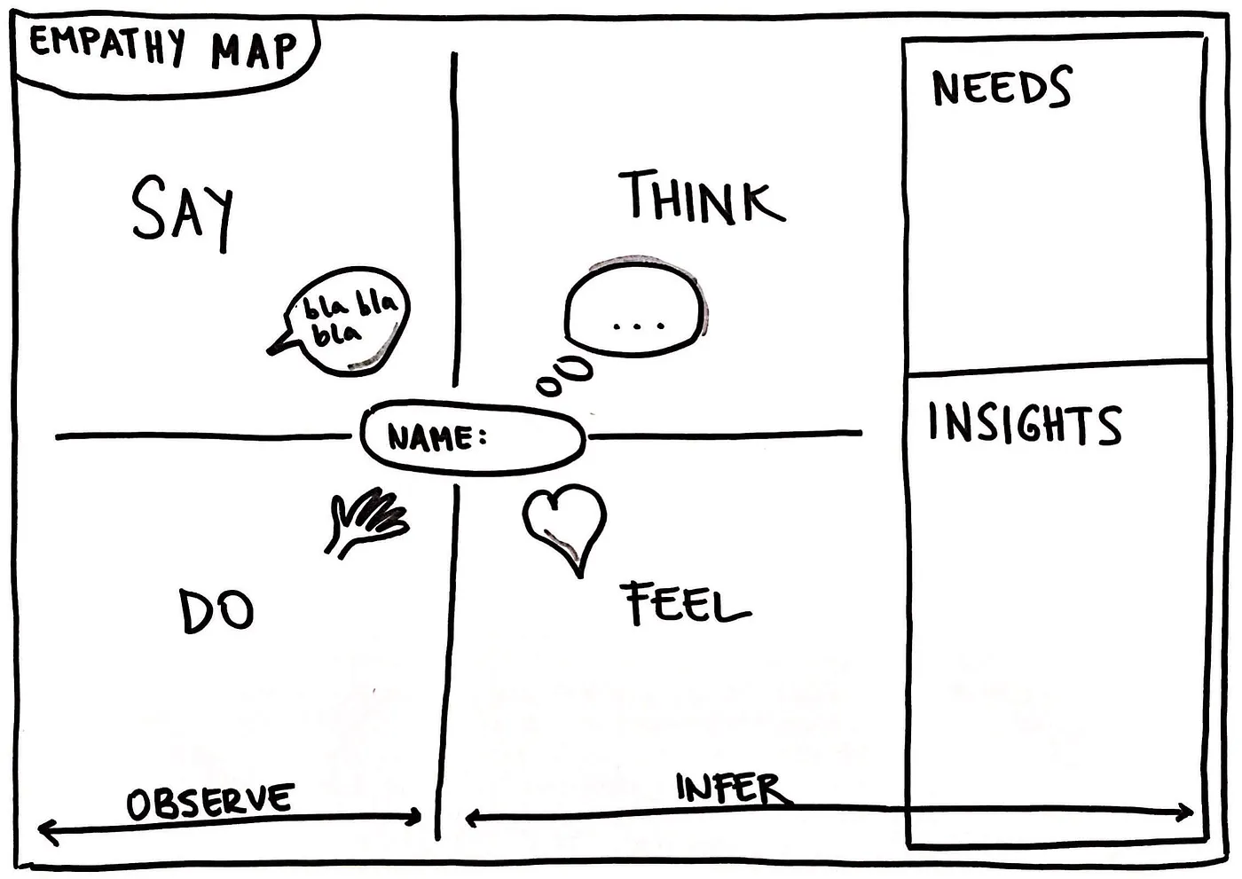
Empathy Map
Empathy maps help team members understand the user’s mindset.
Notes:
https://www.nngroup.com/articles/empathy-mapping/
The Says quadrant contains what the user says out loud in an interview or some other usability study. Ideally, it contains verbatim and direct quotes from research.
Related course: Generating Big Ideas with Design Thinking
“I am allegiant to Delta because I never have a bad experience.”
“I want something reliable.”
“I don’t understand what to do from here.”
The Thinks quadrant captures what the user is thinking throughout the experience. Ask yourself (from the qualitative research gathered): what occupies the user’s thoughts? What matters to the user? It is possible to have the same content in both Says and Thinks. However, pay special attention to what users think, but may not be willing to vocalize. Try to understand why they are reluctant to share — are they unsure, self-conscious, polite, or afraid to tell others something?
“This is really annoying.”
“Am I dumb for not understanding this?”
The Does quadrant encloses the actions the user takes. From the research, what does the user physically do? How does the user go about doing it?
Refreshes page several times.
Shops around to compare prices.
The Feels quadrant is the user’s emotional state, often represented as an adjective plus a short sentence for context. Ask yourself: what worries the user? What does the user get excited about? How does the user feel about the experience?
Impatient: pages load too slowly
Confused: too many contradictory prices
Worried: they are doing something wrong
Design thinking is a non-linear, iterative process that can have anywhere from three to seven phases, depending on whom you talk to.
Lets focus on the five-stage design thinking model proposed by the Hasso Plattner Institute of Design at Stanford (the d.school) because they are world-renowned for the way they teach and apply design thinking.
The five stages of design thinking, according to the d.school, are:
Empathize: research your users' needs.
Define: state your users' needs and problems.
Ideate: challenge assumptions and create ideas.
Prototype: start to create solutions.
Test: try your solutions out.
Design thinking is a non-linear, iterative process that can have anywhere from three to seven phases, depending on whom you talk to.
Lets focus on the five-stage design thinking model proposed by the Hasso Plattner Institute of Design at Stanford (the d.school) because they are world-renowned for the way they teach and apply design thinking.
The five stages of design thinking, according to the d.school, are:
Empathize: research your users' needs.
Define: state your users' needs and problems.
Ideate: challenge assumptions and create ideas.
Prototype: start to create solutions.
Test: try your solutions out.
a person's perceptions and responses that result from the use or anticipated use of a product system
or service.
That's a lot.
So let's break this one down into pieces, too.
So it's a pursuit, a person's perceptions and responses of their anticipated use.
It's before they even use your product system or service.
You might be scratching your head, perhaps what they read about it in the marketing material, what
someone else has told them about it, how they first became exposed to know that your product system
or service even exists.
That's the anticipated use.
What is that mindset?
Those perceptions and responses that they have as they're sitting down before they've even started to
use your product system or service?
Have they heard that your product system or service is easy to use its user friendly?
It's a delightful experience.
Or perhaps have they heard that?
It just seems clunky, it's cumbersome, it's difficult to use.
It's confusing, it's frustrating.
That's all part of the user experience, these preconceived notions that they bring with them when they
sit down to use your product system or service.
And of course, it's while they're actually using your product.
As they go through interacting with your product, is it responding in a way that they would expect?
Is it useful to them?
Is it usable?
Is it delightful?
Do they enjoy using it?
Do they look forward to using it again?
Would they tell other people that it's fantastic.
I enjoyed using this.
It was helpful for me.
It helped me achieve some tasks and that they should suggest other people to use it as well.
So it's both that preconceived notion before they even start to use your product, kind of that referral
of the people telling them about it, what they've read from their marketing materials.
And of course, while they're actually using a product system or service.
I like to break it down into three simple pieces.
I've kind of already mentioned some of these words first.
Is it useful?
Does it help them achieve something?
Does it help them accomplish some tasks, some workflows that they can provide information and they
can get some results back?
Is it useful to them?
Second, is it usable?
Is it user friendly?
It's sort of from the inverse.
It avoids points of confusion, points of frustration.
They're able to understand your interface.
There's an easy learning curve to understand kind of the cadence of how your system works, where things
typically are located in the interface.
When they interact with something, it gives them an anticipated results or interaction back.
That's kind of more from the usable perspective.
And third.
Is it delightful?
Does it put a smile on their face?
Even systems I've worked on that were for very complex enterprise systems, processing millions of data
records in the utility industry or even in the medical industry.
It can still put a smile on someone's face that it helped them achieve their job.
It was efficient, it was effective.
It even put a smile and that they looked forward to using your your product system or service.
Once again, the delight factor.
So this was just a quick look at some of the definitions for user centered design and user experience.

Slide 10
Empathy Map
Definition: An empathy map is a tool used to articulate what we know about a particular type of user. It externalizes user knowledge in order to 1) create a shared understanding, and 2) aid in decision making.
Characteristics:
The map is split into 4 quadrants: Says, Thinks, Feels, Does.
It shows user’s perspective regarding the tasks related to the product.
It is not chronological or sequential.
There is one empathy map for each persona or user type (1:1 mapping).
Why use it:
To build empathy for your users
To force alignment and understanding about a user type
When to use it:
Beginning of any design process
When categorizing research notes from a user interview
A persona is a fictional, yet realistic, description of a typical or target user of the product.
A persona is an archetype instead of an actual living human, but personas should be described as if they were real people.
Notes:
https://www.interaction-design.org/literature/article/5-stages-in-the-design-thinking-process
https://careerfoundry.com/en/blog/ux-design/what-is-empathy-in-design-thinking/
The literary meaning of empathy is the ability to understand and share the feelings of another.
Empathy is defined as “the action of understanding, being aware of, being sensitive to, and vicariously experiencing the feelings, thoughts, and experience of another without having the feelings, thoughts, and experience fully communicated in an objectively explicit manner.”
It describes the ability to put yourself in another person’s shoes; to truly see the world through their eyes in a given context or situation.
In a social context, empathy is often what drives us to take action. If we see people suffering or struggling, and we are able to empathise with their situation, we are compelled to help relieve them in some way.
Designers need to build empathy for their users in order to take the right course of action. It’s important to understand how the user feels when interacting with a certain product or interface; does the layout of this website evoke feelings of frustration? What emotions does the user go through when navigating this app?
In building empathy, designers can create products which truly please the user and make their lives easier. Without this empathy, the design process lacks that all-important user-centricity which often marks the distinction between product success and failure.
Design thinking is a non-linear, iterative process that can have anywhere from three to seven phases, depending on whom you talk to.
Lets focus on the five-stage design thinking model proposed by the Hasso Plattner Institute of Design at Stanford (the d.school) because they are world-renowned for the way they teach and apply design thinking.
The five stages of design thinking, according to the d.school, are:
Empathize: research your users' needs.
Define: state your users' needs and problems.
Ideate: challenge assumptions and create ideas.
Prototype: start to create solutions.
Test: try your solutions out.
Design thinking is a non-linear, iterative process that can have anywhere from three to seven phases, depending on whom you talk to.
Lets focus on the five-stage design thinking model proposed by the Hasso Plattner Institute of Design at Stanford (the d.school) because they are world-renowned for the way they teach and apply design thinking.
The five stages of design thinking, according to the d.school, are:
Empathize: research your users' needs.
Define: state your users' needs and problems.
Ideate: challenge assumptions and create ideas.
Prototype: start to create solutions.
Test: try your solutions out.
a person's perceptions and responses that result from the use or anticipated use of a product system
or service.
That's a lot.
So let's break this one down into pieces, too.
So it's a pursuit, a person's perceptions and responses of their anticipated use.
It's before they even use your product system or service.
You might be scratching your head, perhaps what they read about it in the marketing material, what
someone else has told them about it, how they first became exposed to know that your product system
or service even exists.
That's the anticipated use.
What is that mindset?
Those perceptions and responses that they have as they're sitting down before they've even started to
use your product system or service?
Have they heard that your product system or service is easy to use its user friendly?
It's a delightful experience.
Or perhaps have they heard that?
It just seems clunky, it's cumbersome, it's difficult to use.
It's confusing, it's frustrating.
That's all part of the user experience, these preconceived notions that they bring with them when they
sit down to use your product system or service.
And of course, it's while they're actually using your product.
As they go through interacting with your product, is it responding in a way that they would expect?
Is it useful to them?
Is it usable?
Is it delightful?
Do they enjoy using it?
Do they look forward to using it again?
Would they tell other people that it's fantastic.
I enjoyed using this.
It was helpful for me.
It helped me achieve some tasks and that they should suggest other people to use it as well.
So it's both that preconceived notion before they even start to use your product, kind of that referral
of the people telling them about it, what they've read from their marketing materials.
And of course, while they're actually using a product system or service.
I like to break it down into three simple pieces.
I've kind of already mentioned some of these words first.
Is it useful?
Does it help them achieve something?
Does it help them accomplish some tasks, some workflows that they can provide information and they
can get some results back?
Is it useful to them?
Second, is it usable?
Is it user friendly?
It's sort of from the inverse.
It avoids points of confusion, points of frustration.
They're able to understand your interface.
There's an easy learning curve to understand kind of the cadence of how your system works, where things
typically are located in the interface.
When they interact with something, it gives them an anticipated results or interaction back.
That's kind of more from the usable perspective.
And third.
Is it delightful?
Does it put a smile on their face?
Even systems I've worked on that were for very complex enterprise systems, processing millions of data
records in the utility industry or even in the medical industry.
It can still put a smile on someone's face that it helped them achieve their job.
It was efficient, it was effective.
It even put a smile and that they looked forward to using your your product system or service.
Once again, the delight factor.
So this was just a quick look at some of the definitions for user centered design and user experience.

Slide 11
Empathy Map
Empathy maps can capture one particular user or can reflect an aggregation of multiple users: One-user (individual) empathy maps are usually based on a user interview or a user’s log from a diary study. Aggregated empathy maps represent a user segment, rather than one particular user. They are usually created by combining multiple individual empathy maps from users who exhibit similar behaviors and can be grouped into one segment.
One User vs. Multiple-Users Empathy Maps
Notes:
https://www.interaction-design.org/literature/article/5-stages-in-the-design-thinking-process
https://careerfoundry.com/en/blog/ux-design/what-is-empathy-in-design-thinking/
The literary meaning of empathy is the ability to understand and share the feelings of another.
Empathy is defined as “the action of understanding, being aware of, being sensitive to, and vicariously experiencing the feelings, thoughts, and experience of another without having the feelings, thoughts, and experience fully communicated in an objectively explicit manner.”
It describes the ability to put yourself in another person’s shoes; to truly see the world through their eyes in a given context or situation.
In a social context, empathy is often what drives us to take action. If we see people suffering or struggling, and we are able to empathise with their situation, we are compelled to help relieve them in some way.
Designers need to build empathy for their users in order to take the right course of action. It’s important to understand how the user feels when interacting with a certain product or interface; does the layout of this website evoke feelings of frustration? What emotions does the user go through when navigating this app?
In building empathy, designers can create products which truly please the user and make their lives easier. Without this empathy, the design process lacks that all-important user-centricity which often marks the distinction between product success and failure.
Design thinking is a non-linear, iterative process that can have anywhere from three to seven phases, depending on whom you talk to.
Lets focus on the five-stage design thinking model proposed by the Hasso Plattner Institute of Design at Stanford (the d.school) because they are world-renowned for the way they teach and apply design thinking.
The five stages of design thinking, according to the d.school, are:
Empathize: research your users' needs.
Define: state your users' needs and problems.
Ideate: challenge assumptions and create ideas.
Prototype: start to create solutions.
Test: try your solutions out.
Design thinking is a non-linear, iterative process that can have anywhere from three to seven phases, depending on whom you talk to.
Lets focus on the five-stage design thinking model proposed by the Hasso Plattner Institute of Design at Stanford (the d.school) because they are world-renowned for the way they teach and apply design thinking.
The five stages of design thinking, according to the d.school, are:
Empathize: research your users' needs.
Define: state your users' needs and problems.
Ideate: challenge assumptions and create ideas.
Prototype: start to create solutions.
Test: try your solutions out.
a person's perceptions and responses that result from the use or anticipated use of a product system
or service.
That's a lot.
So let's break this one down into pieces, too.
So it's a pursuit, a person's perceptions and responses of their anticipated use.
It's before they even use your product system or service.
You might be scratching your head, perhaps what they read about it in the marketing material, what
someone else has told them about it, how they first became exposed to know that your product system
or service even exists.
That's the anticipated use.
What is that mindset?
Those perceptions and responses that they have as they're sitting down before they've even started to
use your product system or service?
Have they heard that your product system or service is easy to use its user friendly?
It's a delightful experience.
Or perhaps have they heard that?
It just seems clunky, it's cumbersome, it's difficult to use.
It's confusing, it's frustrating.
That's all part of the user experience, these preconceived notions that they bring with them when they
sit down to use your product system or service.
And of course, it's while they're actually using your product.
As they go through interacting with your product, is it responding in a way that they would expect?
Is it useful to them?
Is it usable?
Is it delightful?
Do they enjoy using it?
Do they look forward to using it again?
Would they tell other people that it's fantastic.
I enjoyed using this.
It was helpful for me.
It helped me achieve some tasks and that they should suggest other people to use it as well.
So it's both that preconceived notion before they even start to use your product, kind of that referral
of the people telling them about it, what they've read from their marketing materials.
And of course, while they're actually using a product system or service.
I like to break it down into three simple pieces.
I've kind of already mentioned some of these words first.
Is it useful?
Does it help them achieve something?
Does it help them accomplish some tasks, some workflows that they can provide information and they
can get some results back?
Is it useful to them?
Second, is it usable?
Is it user friendly?
It's sort of from the inverse.
It avoids points of confusion, points of frustration.
They're able to understand your interface.
There's an easy learning curve to understand kind of the cadence of how your system works, where things
typically are located in the interface.
When they interact with something, it gives them an anticipated results or interaction back.
That's kind of more from the usable perspective.
And third.
Is it delightful?
Does it put a smile on their face?
Even systems I've worked on that were for very complex enterprise systems, processing millions of data
records in the utility industry or even in the medical industry.
It can still put a smile on someone's face that it helped them achieve their job.
It was efficient, it was effective.
It even put a smile and that they looked forward to using your your product system or service.
Once again, the delight factor.
So this was just a quick look at some of the definitions for user centered design and user experience.

Slide 12
Empathy Map
1. Define scope and goals a. What user or persona will you map? b. Define your primary purpose for empathy mapping 2. Gather materials 3. Collect research 4. Individually generate sticky notes for each quadrant 5. Converge to cluster and synthesize
Process: How to Build an Empathy Map
Notes:
https://www.nngroup.com/articles/empathy-mapping/
1. Define scope and goals
a. What user or persona will you map? Will you map a persona or an individual user? Always start with a 1:1 mapping (1 user/persona per empathy map). This means that, if you have multiple personas, there should be an empathy map for each.
b. Define your primary purpose for empathy mapping. Is it to align the team on your user? If so, be sure everyone is present during the empathy-mapping activity. Is it to analyze an interview transcript? If so, set a clear scope and timebox your effort to ensure you have time to map multiple user interviews.
2. Gather materials
Your purpose should dictate the medium you use to create an empathy map. If you will be working with an entire team, have a large whiteboard, sticky notes, and markers readily available. (The outcome will look somewhat like the illustration above.) If empathy mapping alone, create a system that works for you. The easier to share out with the rest of the team, the better.
3. Collect research
Gather the research you will be using to fuel your empathy map. Empathy mapping is a qualitative method, so you will need qualitative inputs: user interviews, field studies, diary studies, listening sessions, or qualitative surveys.
4. Individually generate sticky notes for each quadrant
Once you have research inputs, you can proceed to mapping as a team. In the beginning, everybody should read through the research individually. As each team member digests the data, they can fill out sticky notes that align to the four quadrants. Next, team members can add their notes to the map on the whiteboard.
5. Converge to cluster and synthesize
In this step, the team moves through the stickies on the board collaboratively and clusters similar notes that belong to the same quadrant. Name your clusters with themes that represent each group (for example, “validation from others” or “research”). Repeat themes in each quadrant if necessary. The activity of clustering facilitates discussion and alignment — the goal being to arrive at a shared understanding of your user by all team members.
Once your empathy map is clustered, you can begin to vocalize and align as a team on your findings. What outliers (or data points that did not fit in any cluster) are there? What themes were repeated in all the quadrants? What themes only exist in one quadrant? What gaps exist in our understanding?
6. Polish and plan
If you feel that you need more detail or you have unique needs, adapt the map by including additional quadrants (like Goals the example below) or by increasing specificity to existing quadrants. Depending on the purpose of your empathy map, polish and digitize the output accordingly. Be sure to include the user, any outstanding questions, the date and version number. Plan to circle back to the empathy map as more research is gathered or to guide UX decisions

Slide 13
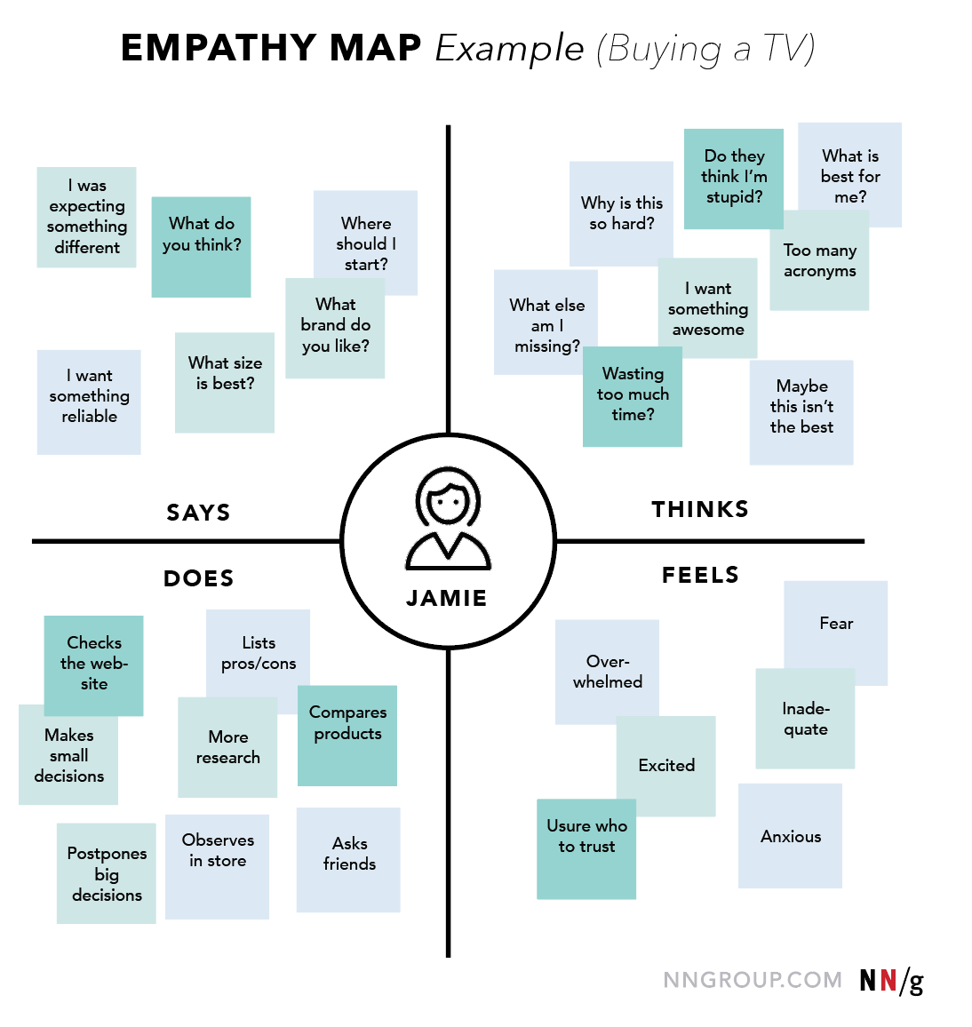
Empathy Mapping Use Case
Notes:
https://www.nngroup.com/articles/ux-mapping-cheat-sheet/

Slide 14
Empathy Mapping Use Cases
Empathy Maps help in empathizing with users, stakeholders, or customers by visualizing their thoughts, feelings, and behaviors. Here are some use cases for empathy maps:
Product Development
Marketing and Advertising
Customer Support and Service
Human Resource and Employee Engagement
Healthcare and Patient Experience
Social work and Community Engagement
User Research and Testing
Business Strategy and Innovation
Education and Training
Notes:
Empathy maps are a valuable tool used in various fields to gain a deeper understanding of a specific group of people or users. They help in empathizing with users, stakeholders, or customers by visualizing their thoughts, feelings, and behaviors. Here are some detailed use cases for empathy maps:
1. User Experience Design:
Empathy maps are widely used in user experience (UX) design to understand the needs, desires, and pain points of users. Designers can create empathy maps to capture the emotions and motivations of target users when interacting with a product or service. This helps them tailor the design to meet users' expectations and create more user-centric solutions.
2. Product Development:
In product development, empathy maps aid in identifying the user's context and potential areas of improvement. By mapping out users' thoughts, behaviors, and attitudes, product teams can prioritize features and functionalities that align with users' goals and aspirations, ultimately leading to a more successful product.
3. Marketing and Advertising:
Empathy maps can be used to understand the target audience's preferences, interests, and pain points. Marketers and advertisers can create empathy maps to design more compelling campaigns that resonate with the intended audience, leading to higher engagement and better response rates.
4. Customer Support and Service:
Empathy maps can help customer support teams develop a deeper understanding of customers' frustrations and needs when seeking assistance. By empathizing with customers, support representatives can provide more personalized and effective solutions, improving overall customer satisfaction and loyalty.
5. Human Resources and Employee Engagement:
Empathy maps are useful in the human resources domain to understand employees' experiences and emotions in the workplace. HR teams can create empathy maps to identify potential issues, enhance employee engagement, and design better internal programs to support the workforce.
6. Healthcare and Patient Experience:
Empathy maps are applied in healthcare settings to gain insights into patients' emotions and experiences during their medical journey. By understanding patients' perspectives, healthcare providers can improve patient care, address concerns, and create a more supportive and empathetic environment.
7. Social Work and Community Engagement:
Empathy maps can be used in social work to better understand the challenges and needs of a particular community. Social workers can use empathy maps to develop targeted programs and interventions that address the unique requirements of the people they serve.
8. User Research and Testing:
Empathy maps are often used as a part of user research and testing processes. Researchers can create empathy maps based on observations, interviews, and user feedback to synthesize the data and uncover key insights about the target audience.
9. Business Strategy and Innovation:
Empathy maps can also be employed in business strategy and innovation efforts. By empathizing with customers and stakeholders, organizations can identify untapped opportunities and gaps in the market, leading to more innovative products and services.
10. Education and Training:
In the field of education, empathy maps can help educators understand their students' needs and emotions, leading to more effective teaching methods and improved learning outcomes.
In summary, empathy maps are versatile tools that can be applied across a wide range of disciplines to foster empathy, gain deeper insights, and make more informed decisions. Whether in design, marketing, customer support, healthcare, or any other domain, empathy maps facilitate better understanding and more human-centered approaches.

Slide 15
Journey Map
What is a UIUX journey map?
A UIUX journey map is a visual representation of the steps a user takes when interacting with a product or service. It typically includes the user's goals, motivations, emotions, and pain points at each stage of the journey.
Why are UIUX journey maps important?
UIUX journey maps are important because they can help you understand your users' needs, pain points, and motivations. This information can be used to improve the user experience of your product or service, making it more intuitive and user-friendly.
There are many benefits to using UIUX journey maps, including:
Improved understanding of your users
Identification of opportunities for improvement
Increased user satisfaction
Reduced costs
Increased sales
Notes:
https://www.nngroup.com/articles/ux-mapping-cheat-sheet/

Slide 16
Journey Map
There are many different ways to create a UIUX journey map. However, the basic steps involved are:
Identify your target users.
Gather data about your users' needs, pain points, and motivations.
Map out the user's journey.
Analyze the data and identify opportunities for improvement.
Implement changes to improve the user experience
Here are some examples of UIUX journey maps from different industries:
A customer journey map for an e-commerce website.
An employee journey map for a software company.
A partner journey map for a marketing agency.
A supplier journey map for a manufacturing company.
Notes:
https://www.nngroup.com/articles/ux-mapping-cheat-sheet/

Slide 17
Journey Map
Characteristics:
The map is tied to a specific product or service.
It is split into 4 swim lanes: phases, actions, thoughts, mindsets/emotions.
It reflects the user’s perspective:
Including her mindset, thoughts, and emotions
Leaving out most process details
It is chronological.
There is one map per persona/user type (1:1 mapping).
Why use it:
To pinpoint specific customer journey touchpoints that cause pain or delight
To break down silos to create one shared, organization-wide understanding of the customer journey
To assign ownership of key touchpoints in the journey to internal departments
When to use it:
At any point in the design process, as a reference point amongst a team throughout a product design cycle
Notes:
https://www.nngroup.com/articles/ux-mapping-cheat-sheet/

Slide 18
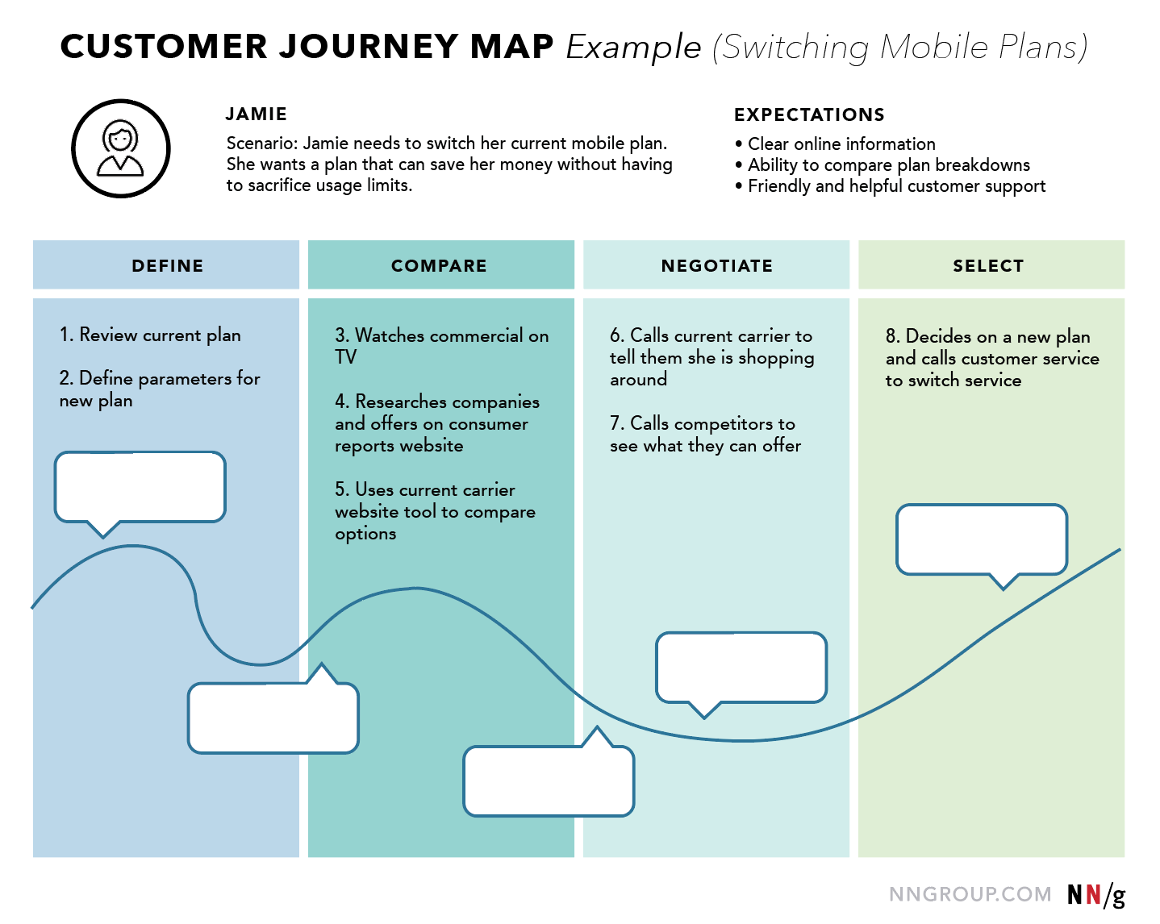
Journey Map
Customer journey maps focus on a specific customer’s interaction with a product or service.
https://github.com/rahul-thakoor/guides/blob/master/src/pages/user-experience-research/customer-journey-maps/index.md
Notes:
https://www.nngroup.com/articles/ux-mapping-cheat-sheet/
Definition: A customer journey map is a visualization of the process that a person goes through in order to accomplish a goal tied to a specific business or product. It’s used for understanding and addressing customer needs and pain points.
In its most basic form, journey mapping starts by compiling a series of user goals and actions into a timeline skeleton. Next, the skeleton is fleshed out with user thoughts and emotions in order to create a narrative. Finally, that narrative is condensed into a visualization used to communicate insights that will inform design processes.

Slide 19
Employee Journey Map
An employee journey map is a visual representation of the steps an employee takes throughout their entire employment lifecycle, from the initial job application to their eventual departure. It typically includes the employee's goals, motivations, emotions, and pain points at each stage of the journey.
The employee journey map can be divided into several stages, including:
Attraction
Recruitment
Onboarding
Performance
Development
Retention
Notes:
An employee journey map is a visual representation of the steps an employee takes throughout their entire employment lifecycle, from the initial job application to their eventual departure. It typically includes the employee's goals, motivations, emotions, and pain points at each stage of the journey.
The employee journey map can be divided into several stages, including:
Attraction: This stage begins when an employee first learns about the company and considers applying for a job. The company's website, job postings, and social media presence should all be designed to attract and engage potential employees.
Recruitment: This stage begins when an employee applies for a job and ends when they are offered a position. The company should make sure that the recruitment process is efficient and effective, and that they provide a positive experience for potential employees.
Onboarding: This stage begins on the employee's first day of work and ends when they are fully integrated into the company. The onboarding process should be designed to help the employee get up to speed on the company's culture, policies, and procedures.
Performance: This stage begins when the employee starts their job and ends when they are evaluated for their performance. The company should provide the employee with the resources and support they need to be successful in their role.
Development: This stage begins when the employee starts to develop their skills and knowledge. The company should provide opportunities for the employee to learn and grow, both on the job and through formal training programs.
Retention: This stage begins when the employee is considering leaving the company and ends when they decide to stay. The company should make sure that they are providing a positive work environment and that they are rewarding employees for their contributions.
The employee journey map can be a valuable tool for understanding the employee experience and identifying opportunities for improvement. By mapping out the employee's journey, the company can identify the pain points and areas where they can improve the employee experience.

Slide 20
Employee Journey Map
Here are some of the benefits of creating an employee journey map
Improved understanding of the employee experience
Identification of opportunities for improvement
Increased employee satisfaction
Reduced costs
Here are some tips for creating an employee journey map
Start by identifying your target audience
Gather data from a variety of sources
Use visuals to communicate the data
Get feedback from employees
Notes:
Here are some tips for creating an employee journey map:
Start by identifying your target audience: The employee journey map should be tailored to the specific needs of your target audience. This will ensure that the map is relevant and accurate.
Gather data from a variety of sources: The employee journey map should be based on data from a variety of sources, including employee surveys, interviews, and focus groups. This will help to ensure that the map is comprehensive and accurate.
Use visuals to communicate the data: The employee journey map should be easy to understand and visually appealing. This will help to ensure that the map is effective in communicating the data to stakeholders.
Get feedback from employees: Once the employee journey map is complete, get feedback from employees to ensure that it is accurate and relevant. This feedback can be used to make improvements to the map.

Slide 21
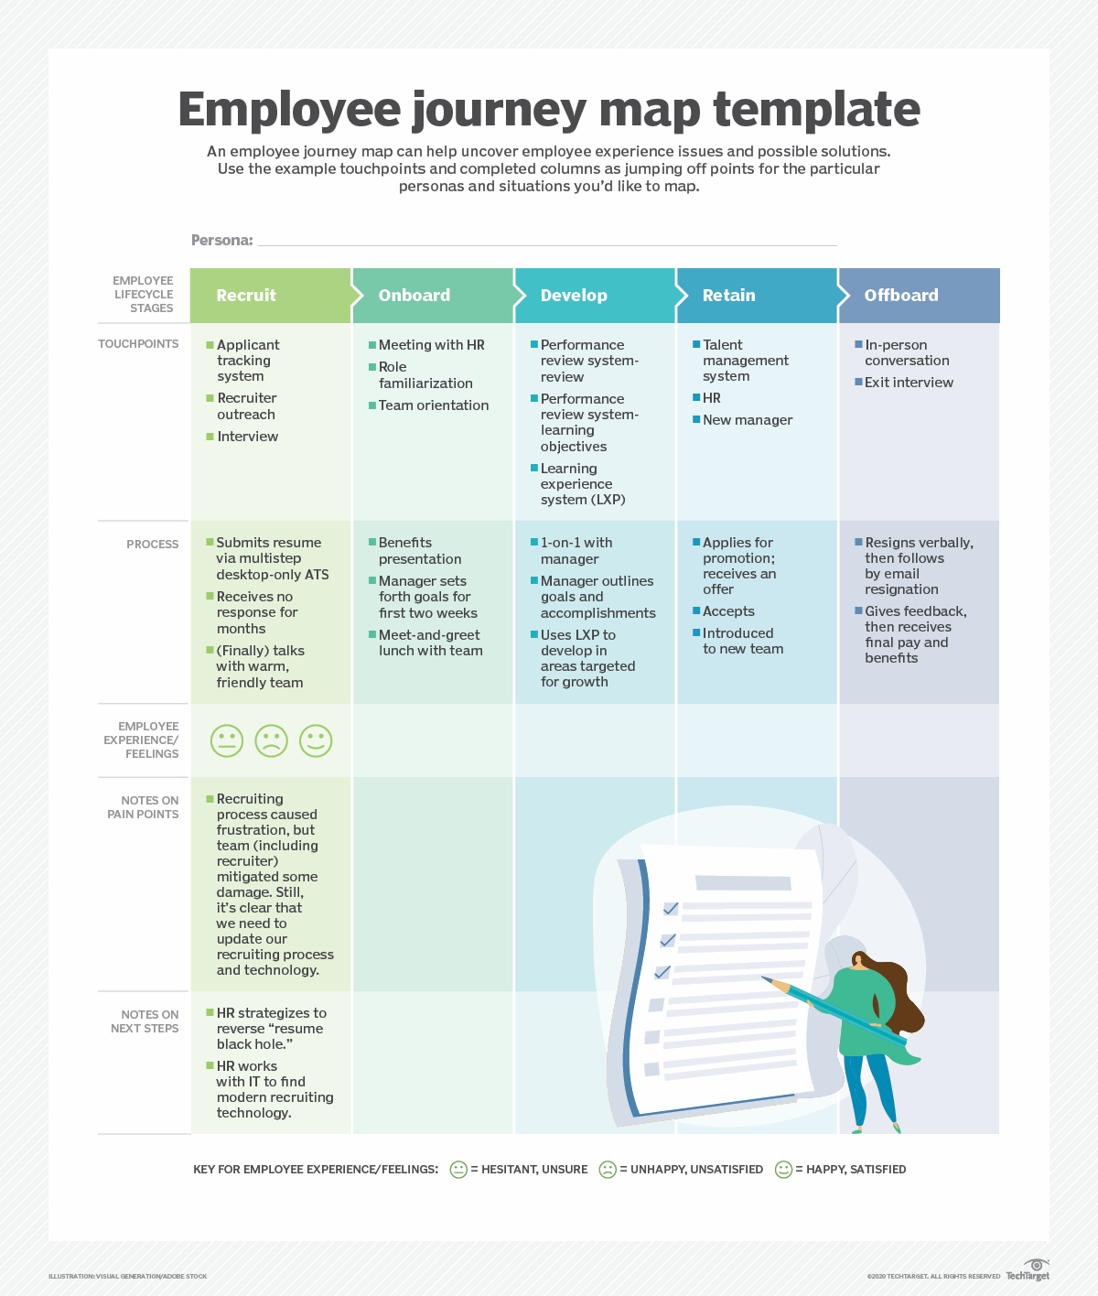
Journey Map
Notes:
https://www.nngroup.com/articles/ux-mapping-cheat-sheet/

Slide 22
Five Stages of the Design Thinking Process
Stage 2: Define—State Your Users' Needs and Problems
In the Define stage, you will organize the information you have gathered during the Empathize stage. You’ll analyze your observations to define the core problems you and your team have identified up to this point
Defining the problem and problem statement must be done in a human-centered manner.
The Define stage will help the design team collect great ideas to establish features, functions and other elements to solve the problem at hand—or, at the very least, allow real users to resolve issues themselves with minimal difficulty
In this stage, you will start to progress to the third stage, the ideation phase
Notes:
https://www.interaction-design.org/literature/article/5-stages-in-the-design-thinking-process
Empathy is crucial to problem solving and a human-centered design process as it allows design thinkers to set aside their own assumptions about the world and gain real insight into users and their needs.
The literary meaning of empathy is the ability to understand and share the feelings of another.
Empathy is defined as “the action of understanding, being aware of, being sensitive to, and vicariously experiencing the feelings, thoughts, and experience of another without having the feelings, thoughts, and experience fully communicated in an objectively explicit manner.”
It describes the ability to put yourself in another person’s shoes; to truly see the world through their eyes in a given context or situation.
In a social context, empathy is often what drives us to take action. If we see people suffering or struggling, and we are able to empathise with their situation, we are compelled to help relieve them in some way.
Designers need to build empathy for their users in order to take the right course of action. It’s important to understand how the user feels when interacting with a certain product or interface; does the layout of this website evoke feelings of frustration? What emotions does the user go through when navigating this app?
In building empathy, designers can create products which truly please the user and make their lives easier. Without this empathy, the design process lacks that all-important user-centricity which often marks the distinction between product success and failure.
Design thinking is a non-linear, iterative process that can have anywhere from three to seven phases, depending on whom you talk to.
Lets focus on the five-stage design thinking model proposed by the Hasso Plattner Institute of Design at Stanford (the d.school) because they are world-renowned for the way they teach and apply design thinking.
The five stages of design thinking, according to the d.school, are:
Empathize: research your users' needs.
Define: state your users' needs and problems.
Ideate: challenge assumptions and create ideas.
Prototype: start to create solutions.
Test: try your solutions out.
Design thinking is a non-linear, iterative process that can have anywhere from three to seven phases, depending on whom you talk to.
Lets focus on the five-stage design thinking model proposed by the Hasso Plattner Institute of Design at Stanford (the d.school) because they are world-renowned for the way they teach and apply design thinking.
The five stages of design thinking, according to the d.school, are:
Empathize: research your users' needs.
Define: state your users' needs and problems.
Ideate: challenge assumptions and create ideas.
Prototype: start to create solutions.
Test: try your solutions out.
a person's perceptions and responses that result from the use or anticipated use of a product system
or service.
That's a lot.
So let's break this one down into pieces, too.
So it's a pursuit, a person's perceptions and responses of their anticipated use.
It's before they even use your product system or service.
You might be scratching your head, perhaps what they read about it in the marketing material, what
someone else has told them about it, how they first became exposed to know that your product system
or service even exists.
That's the anticipated use.
What is that mindset?
Those perceptions and responses that they have as they're sitting down before they've even started to
use your product system or service?
Have they heard that your product system or service is easy to use its user friendly?
It's a delightful experience.
Or perhaps have they heard that?
It just seems clunky, it's cumbersome, it's difficult to use.
It's confusing, it's frustrating.
That's all part of the user experience, these preconceived notions that they bring with them when they
sit down to use your product system or service.
And of course, it's while they're actually using your product.
As they go through interacting with your product, is it responding in a way that they would expect?
Is it useful to them?
Is it usable?
Is it delightful?
Do they enjoy using it?
Do they look forward to using it again?
Would they tell other people that it's fantastic.
I enjoyed using this.
It was helpful for me.
It helped me achieve some tasks and that they should suggest other people to use it as well.
So it's both that preconceived notion before they even start to use your product, kind of that referral
of the people telling them about it, what they've read from their marketing materials.
And of course, while they're actually using a product system or service.
I like to break it down into three simple pieces.
I've kind of already mentioned some of these words first.
Is it useful?
Does it help them achieve something?
Does it help them accomplish some tasks, some workflows that they can provide information and they
can get some results back?
Is it useful to them?
Second, is it usable?
Is it user friendly?
It's sort of from the inverse.
It avoids points of confusion, points of frustration.
They're able to understand your interface.
There's an easy learning curve to understand kind of the cadence of how your system works, where things
typically are located in the interface.
When they interact with something, it gives them an anticipated results or interaction back.
That's kind of more from the usable perspective.
And third.
Is it delightful?
Does it put a smile on their face?
Even systems I've worked on that were for very complex enterprise systems, processing millions of data
records in the utility industry or even in the medical industry.
It can still put a smile on someone's face that it helped them achieve their job.
It was efficient, it was effective.
It even put a smile and that they looked forward to using your your product system or service.
Once again, the delight factor.
So this was just a quick look at some of the definitions for user centered design and user experience.

Slide 23
Five Stages of the Design Thinking Process
Stage 3: Ideate—Challenge Assumptions and Create Ideas
During the third stage of the design thinking process, designers are ready to generate ideas
You’ve grown to understand your users and their needs in the Empathize stage, and you’ve analyzed your observations in the Define stage to create a user centric problem statement
With this solid background, you and your team members can start to look at the problem from different perspectives and ideate innovative solutions to your problem statement.
Notes:
https://www.interaction-design.org/literature/article/5-stages-in-the-design-thinking-process
There are hundreds of ideation techniques you can use—such as Brainstorm, Brainwrite, Worst Possible Idea and SCAMPER. Brainstorm and Worst Possible Idea techniques are typically used at the start of the ideation stage to stimulate free thinking and expand the problem space. This allows you to generate as many ideas as possible at the start of ideation. You should pick other ideation techniques towards the end of this stage to help you investigate and test your ideas, and choose the best ones to move forward with—either because they seem to solve the problem or provide the elements required to circumvent it.

Slide 24
Five Stages of the Design Thinking Process
Stage 4: Prototype—Start to Create Solutions
This is an experimental phase, and the aim is to identify the best possible solution for each of the problems identified during the first three stages
The solutions are implemented within the prototypes and, one by one, they are investigated and then accepted, improved or rejected based on the users’ experiences
By the end of the Prototype stage, the design team will have a better idea of the product’s limitations and the problems it faces. They’ll also have a clearer view of how real users would behave, think and feel when they interact with the end product.
Notes:
https://www.interaction-design.org/literature/article/5-stages-in-the-design-thinking-process
Prototype: the fourth phase of design thinking, where you identify the best possible solution.
The design team will now produce a number of inexpensive, scaled down versions of the product (or specific features found within the product) to investigate the key solutions generated in the ideation phase. These prototypes can be shared and tested within the team itself, in other departments or on a small group of people outside the design team.

Slide 25
Five Stages of the Design Thinking Process
Stage 5: Test—Try Your Solutions Out
Designers or evaluators rigorously test the complete product using the best solutions identified in the Prototype stage
This is the final stage of the five-stage model; however, in an iterative process such as design thinking, the results generated are often used to redefine one or more further problems
This increased level of understanding may help you investigate the conditions of use and how people think, behave and feel towards the product, and even lead you to loop back to a previous stage in the design thinking process
Notes:
https://www.interaction-design.org/literature/article/5-stages-in-the-design-thinking-process
There are hundreds of ideation techniques you can use—such as Brainstorm, Brainwrite, Worst Possible Idea and SCAMPER. Brainstorm and Worst Possible Idea techniques are typically used at the start of the ideation stage to stimulate free thinking and expand the problem space. This allows you to generate as many ideas as possible at the start of ideation. You should pick other ideation techniques towards the end of this stage to help you investigate and test your ideas, and choose the best ones to move forward with—either because they seem to solve the problem or provide the elements required to circumvent it.

Slide 26
User Interface (UI)
User interface(UI), involves every visual part of a digital product/service that a user interacts with. This includes mobile apps, websites, screens, touchscreens, keyboards, and wearable technology such as smartwatches, to name a few.
You can think of it as the bridge between the user and technology.
A UI designer is responsible for designing every step that allows a user to interact with the digital product/service. This includes layouts, structure, buttons, colors, and animations.
UI design is all about the look, feel, and aesthetics of a digital product. It involves every visual aspect and appearance of the product the user interacts with.
The end goal of a UI designer is to make something visually appealing to the user that's easy to interact with.
Notes:
https://www.uxdesigninstitute.com/blog/ux-vs-ui-design/
a person's perceptions and responses that result from the use or anticipated use of a product system
or service.
That's a lot.
So let's break this one down into pieces, too.
So it's a pursuit, a person's perceptions and responses of their anticipated use.
It's before they even use your product system or service.
You might be scratching your head, perhaps what they read about it in the marketing material, what
someone else has told them about it, how they first became exposed to know that your product system
or service even exists.
That's the anticipated use.
What is that mindset?
Those perceptions and responses that they have as they're sitting down before they've even started to
use your product system or service?
Have they heard that your product system or service is easy to use its user friendly?
It's a delightful experience.
Or perhaps have they heard that?
It just seems clunky, it's cumbersome, it's difficult to use.
It's confusing, it's frustrating.
That's all part of the user experience, these preconceived notions that they bring with them when they
sit down to use your product system or service.
And of course, it's while they're actually using your product.
As they go through interacting with your product, is it responding in a way that they would expect?
Is it useful to them?
Is it usable?
Is it delightful?
Do they enjoy using it?
Do they look forward to using it again?
Would they tell other people that it's fantastic.
I enjoyed using this.
It was helpful for me.
It helped me achieve some tasks and that they should suggest other people to use it as well.
So it's both that preconceived notion before they even start to use your product, kind of that referral
of the people telling them about it, what they've read from their marketing materials.
And of course, while they're actually using a product system or service.
I like to break it down into three simple pieces.
I've kind of already mentioned some of these words first.
Is it useful?
Does it help them achieve something?
Does it help them accomplish some tasks, some workflows that they can provide information and they
can get some results back?
Is it useful to them?
Second, is it usable?
Is it user friendly?
It's sort of from the inverse.
It avoids points of confusion, points of frustration.
They're able to understand your interface.
There's an easy learning curve to understand kind of the cadence of how your system works, where things
typically are located in the interface.
When they interact with something, it gives them an anticipated results or interaction back.
That's kind of more from the usable perspective.
And third.
Is it delightful?
Does it put a smile on their face?
Even systems I've worked on that were for very complex enterprise systems, processing millions of data
records in the utility industry or even in the medical industry.
It can still put a smile on someone's face that it helped them achieve their job.
It was efficient, it was effective.
It even put a smile and that they looked forward to using your your product system or service.
Once again, the delight factor.
So this was just a quick look at some of the definitions for user centered design and user experience.

Slide 27
Designing User Interfaces for the Users
User interfaces are the access points where users interact with designs. They come in three formats:
Graphical user interfaces (GUIs)—Users interact with visual representations on digital control panels. A computer’s desktop is a GUI.
Voice-controlled interfaces (VUIs)—Users interact with these through their voices. Most smart assistants—e.g., Siri on iPhone and Alexa on Amazon devices—are VUIs.
Gesture-based interfaces—Users engage with 3D design spaces through bodily motions: e.g., in virtual reality (VR) games.
Notes:
https://www.interaction-design.org/literature/topics/ui-design
a person's perceptions and responses that result from the use or anticipated use of a product system
or service.
That's a lot.
So let's break this one down into pieces, too.
So it's a pursuit, a person's perceptions and responses of their anticipated use.
It's before they even use your product system or service.
You might be scratching your head, perhaps what they read about it in the marketing material, what
someone else has told them about it, how they first became exposed to know that your product system
or service even exists.
That's the anticipated use.
What is that mindset?
Those perceptions and responses that they have as they're sitting down before they've even started to
use your product system or service?
Have they heard that your product system or service is easy to use its user friendly?
It's a delightful experience.
Or perhaps have they heard that?
It just seems clunky, it's cumbersome, it's difficult to use.
It's confusing, it's frustrating.
That's all part of the user experience, these preconceived notions that they bring with them when they
sit down to use your product system or service.
And of course, it's while they're actually using your product.
As they go through interacting with your product, is it responding in a way that they would expect?
Is it useful to them?
Is it usable?
Is it delightful?
Do they enjoy using it?
Do they look forward to using it again?
Would they tell other people that it's fantastic.
I enjoyed using this.
It was helpful for me.
It helped me achieve some tasks and that they should suggest other people to use it as well.
So it's both that preconceived notion before they even start to use your product, kind of that referral
of the people telling them about it, what they've read from their marketing materials.
And of course, while they're actually using a product system or service.
I like to break it down into three simple pieces.
I've kind of already mentioned some of these words first.
Is it useful?
Does it help them achieve something?
Does it help them accomplish some tasks, some workflows that they can provide information and they
can get some results back?
Is it useful to them?
Second, is it usable?
Is it user friendly?
It's sort of from the inverse.
It avoids points of confusion, points of frustration.
They're able to understand your interface.
There's an easy learning curve to understand kind of the cadence of how your system works, where things
typically are located in the interface.
When they interact with something, it gives them an anticipated results or interaction back.
That's kind of more from the usable perspective.
And third.
Is it delightful?
Does it put a smile on their face?
Even systems I've worked on that were for very complex enterprise systems, processing millions of data
records in the utility industry or even in the medical industry.
It can still put a smile on someone's face that it helped them achieve their job.
It was efficient, it was effective.
It even put a smile and that they looked forward to using your your product system or service.
Once again, the delight factor.
So this was just a quick look at some of the definitions for user centered design and user experience.

Slide 28
User Interface (UI) vs. User Experience (UX) Design
UX design is the careful planning and creation of the user experience and everything it entails. It focuses first and foremost on creating a product or service that solves a particular user problem, making sure the proposed solution is easy and enjoyable to use.
UI design is the process of designing how digital interfaces look and behave. It covers all the visual and interactive properties of websites, software and apps—from colours and typography to buttons, scroll functions, animations and more.
Notes:
https://www.uxdesigninstitute.com/blog/ux-vs-ui-design/
a person's perceptions and responses that result from the use or anticipated use of a product system
or service.
That's a lot.
So let's break this one down into pieces, too.
So it's a pursuit, a person's perceptions and responses of their anticipated use.
It's before they even use your product system or service.
You might be scratching your head, perhaps what they read about it in the marketing material, what
someone else has told them about it, how they first became exposed to know that your product system
or service even exists.
That's the anticipated use.
What is that mindset?
Those perceptions and responses that they have as they're sitting down before they've even started to
use your product system or service?
Have they heard that your product system or service is easy to use its user friendly?
It's a delightful experience.
Or perhaps have they heard that?
It just seems clunky, it's cumbersome, it's difficult to use.
It's confusing, it's frustrating.
That's all part of the user experience, these preconceived notions that they bring with them when they
sit down to use your product system or service.
And of course, it's while they're actually using your product.
As they go through interacting with your product, is it responding in a way that they would expect?
Is it useful to them?
Is it usable?
Is it delightful?
Do they enjoy using it?
Do they look forward to using it again?
Would they tell other people that it's fantastic.
I enjoyed using this.
It was helpful for me.
It helped me achieve some tasks and that they should suggest other people to use it as well.
So it's both that preconceived notion before they even start to use your product, kind of that referral
of the people telling them about it, what they've read from their marketing materials.
And of course, while they're actually using a product system or service.
I like to break it down into three simple pieces.
I've kind of already mentioned some of these words first.
Is it useful?
Does it help them achieve something?
Does it help them accomplish some tasks, some workflows that they can provide information and they
can get some results back?
Is it useful to them?
Second, is it usable?
Is it user friendly?
It's sort of from the inverse.
It avoids points of confusion, points of frustration.
They're able to understand your interface.
There's an easy learning curve to understand kind of the cadence of how your system works, where things
typically are located in the interface.
When they interact with something, it gives them an anticipated results or interaction back.
That's kind of more from the usable perspective.
And third.
Is it delightful?
Does it put a smile on their face?
Even systems I've worked on that were for very complex enterprise systems, processing millions of data
records in the utility industry or even in the medical industry.
It can still put a smile on someone's face that it helped them achieve their job.
It was efficient, it was effective.
It even put a smile and that they looked forward to using your your product system or service.
Once again, the delight factor.
So this was just a quick look at some of the definitions for user centered design and user experience.

Slide 29
Designing User Interfaces for the Users: Case Study
UIs should also be enjoyable (or at least satisfying and frustration-free).
When your design predicts users’ needs, they can enjoy more personalized and immersive experiences. Delight them, and they’ll keep returning.
Where appropriate, elements of gamification can make your design more fun.
UIs should communicate brand values and reinforce users’ trust.
Good design is emotional design. Users associate good feelings with brands that speak to them at all levels and keep the magic of pleasurable, seamless experiences alive.
Notes:
https://www.interaction-design.org/literature/topics/ui-design
a person's perceptions and responses that result from the use or anticipated use of a product system
or service.
That's a lot.
So let's break this one down into pieces, too.
So it's a pursuit, a person's perceptions and responses of their anticipated use.
It's before they even use your product system or service.
You might be scratching your head, perhaps what they read about it in the marketing material, what
someone else has told them about it, how they first became exposed to know that your product system
or service even exists.
That's the anticipated use.
What is that mindset?
Those perceptions and responses that they have as they're sitting down before they've even started to
use your product system or service?
Have they heard that your product system or service is easy to use its user friendly?
It's a delightful experience.
Or perhaps have they heard that?
It just seems clunky, it's cumbersome, it's difficult to use.
It's confusing, it's frustrating.
That's all part of the user experience, these preconceived notions that they bring with them when they
sit down to use your product system or service.
And of course, it's while they're actually using your product.
As they go through interacting with your product, is it responding in a way that they would expect?
Is it useful to them?
Is it usable?
Is it delightful?
Do they enjoy using it?
Do they look forward to using it again?
Would they tell other people that it's fantastic.
I enjoyed using this.
It was helpful for me.
It helped me achieve some tasks and that they should suggest other people to use it as well.
So it's both that preconceived notion before they even start to use your product, kind of that referral
of the people telling them about it, what they've read from their marketing materials.
And of course, while they're actually using a product system or service.
I like to break it down into three simple pieces.
I've kind of already mentioned some of these words first.
Is it useful?
Does it help them achieve something?
Does it help them accomplish some tasks, some workflows that they can provide information and they
can get some results back?
Is it useful to them?
Second, is it usable?
Is it user friendly?
It's sort of from the inverse.
It avoids points of confusion, points of frustration.
They're able to understand your interface.
There's an easy learning curve to understand kind of the cadence of how your system works, where things
typically are located in the interface.
When they interact with something, it gives them an anticipated results or interaction back.
That's kind of more from the usable perspective.
And third.
Is it delightful?
Does it put a smile on their face?
Even systems I've worked on that were for very complex enterprise systems, processing millions of data
records in the utility industry or even in the medical industry.
It can still put a smile on someone's face that it helped them achieve their job.
It was efficient, it was effective.
It even put a smile and that they looked forward to using your your product system or service.
Once again, the delight factor.
So this was just a quick look at some of the definitions for user centered design and user experience.

Slide 30
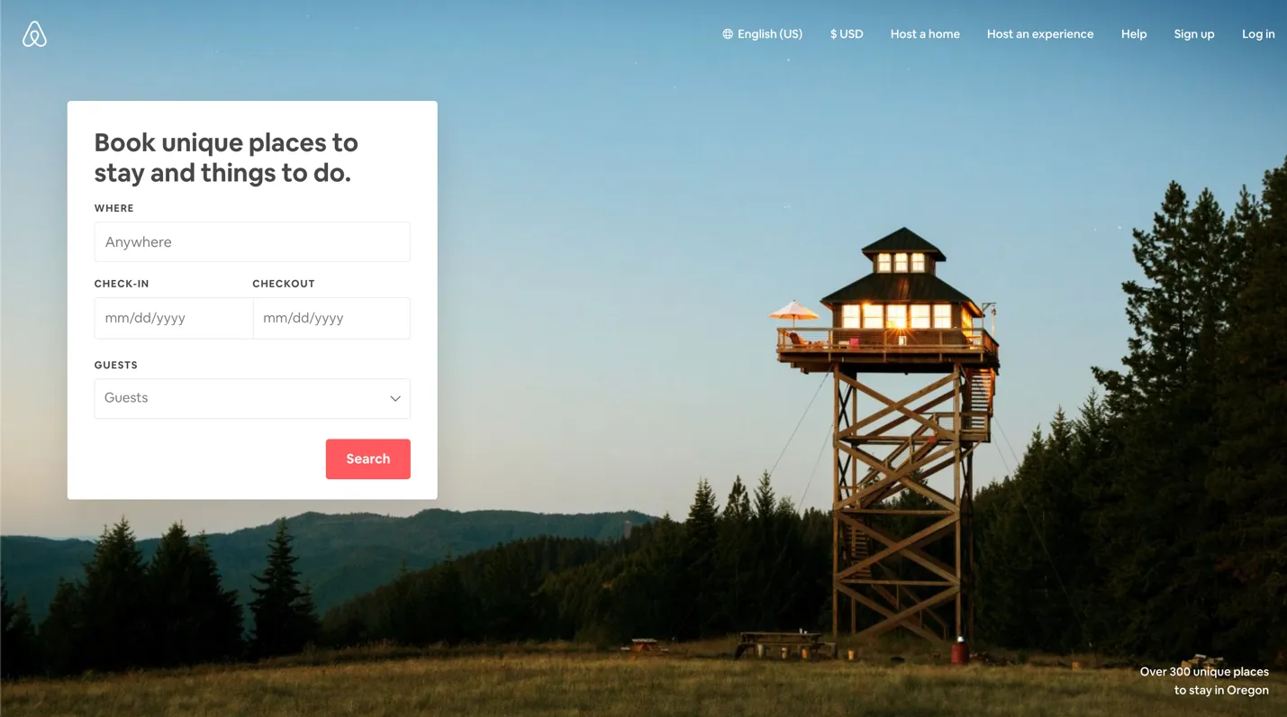
User Interface Example
Airbnb’s simple, inviting layout lets users satisfy their travel needs quickly, easily and enjoyably.
Notes:
https://www.interaction-design.org/literature/topics/ui-design
a person's perceptions and responses that result from the use or anticipated use of a product system
or service.
That's a lot.
So let's break this one down into pieces, too.
So it's a pursuit, a person's perceptions and responses of their anticipated use.
It's before they even use your product system or service.
You might be scratching your head, perhaps what they read about it in the marketing material, what
someone else has told them about it, how they first became exposed to know that your product system
or service even exists.
That's the anticipated use.
What is that mindset?
Those perceptions and responses that they have as they're sitting down before they've even started to
use your product system or service?
Have they heard that your product system or service is easy to use its user friendly?
It's a delightful experience.
Or perhaps have they heard that?
It just seems clunky, it's cumbersome, it's difficult to use.
It's confusing, it's frustrating.
That's all part of the user experience, these preconceived notions that they bring with them when they
sit down to use your product system or service.
And of course, it's while they're actually using your product.
As they go through interacting with your product, is it responding in a way that they would expect?
Is it useful to them?
Is it usable?
Is it delightful?
Do they enjoy using it?
Do they look forward to using it again?
Would they tell other people that it's fantastic.
I enjoyed using this.
It was helpful for me.
It helped me achieve some tasks and that they should suggest other people to use it as well.
So it's both that preconceived notion before they even start to use your product, kind of that referral
of the people telling them about it, what they've read from their marketing materials.
And of course, while they're actually using a product system or service.
I like to break it down into three simple pieces.
I've kind of already mentioned some of these words first.
Is it useful?
Does it help them achieve something?
Does it help them accomplish some tasks, some workflows that they can provide information and they
can get some results back?
Is it useful to them?
Second, is it usable?
Is it user friendly?
It's sort of from the inverse.
It avoids points of confusion, points of frustration.
They're able to understand your interface.
There's an easy learning curve to understand kind of the cadence of how your system works, where things
typically are located in the interface.
When they interact with something, it gives them an anticipated results or interaction back.
That's kind of more from the usable perspective.
And third.
Is it delightful?
Does it put a smile on their face?
Even systems I've worked on that were for very complex enterprise systems, processing millions of data
records in the utility industry or even in the medical industry.
It can still put a smile on someone's face that it helped them achieve their job.
It was efficient, it was effective.
It even put a smile and that they looked forward to using your your product system or service.
Once again, the delight factor.
So this was just a quick look at some of the definitions for user centered design and user experience.

Slide 31
Story Boards
What is a UIUX storyboard?
A UIUX storyboard is a visual representation of the steps a user takes when interacting with a product or service. It typically includes the user's goals, motivations, emotions, and pain points at each stage of the journey.
Why are UIUX storyboards important?
UIUX storyboards are important because they can help you understand your users' needs, pain points, and motivations. This information can be used to improve the user experience of your product or service, making it more intuitive and user-friendly.
https://www.freecodecamp.org/news/airpeace-website-a-ux-case-study-e0ef593f2619/
Notes:
https://www.freecodecamp.org/news/airpeace-website-a-ux-case-study-e0ef593f2619/
What is a UIUX storyboard?
A UIUX storyboard is a visual representation of the steps a user takes when interacting with a product or service. It typically includes the user's goals, motivations, emotions, and pain points at each stage of the journey.
Why are UIUX storyboards important?
UIUX storyboards are important because they can help you understand your users' needs, pain points, and motivations. This information can be used to improve the user experience of your product or service, making it more intuitive and user-friendly.
What are the benefits of using UIUX storyboards?
There are many benefits to using UIUX storyboards, including:
Improved understanding of your users: By mapping out the user's journey, you can gain a better understanding of their needs, pain points, and motivations. This understanding can be used to improve the user experience of your product or service.
Identification of opportunities for improvement: By identifying the pain points in the user's journey, you can identify opportunities for improvement. This information can be used to make changes to the product or service, making it more user-friendly.
Communication with stakeholders: UIUX storyboards can be used to communicate the user experience of your product or service to stakeholders. This can help to ensure that everyone is on the same page and that the product or service is developed with the user in mind.
How to create a UIUX storyboard?
There are many different ways to create a UIUX storyboard. However, the basic steps involved are:
Identify your target users.
Gather data about your users' needs, pain points, and motivations.
Map out the user's journey.
Create visuals to represent the user's journey.
Get feedback from users and stakeholders.
Here are some tips for creating a UIUX storyboard:
Start by identifying your target users: The UIUX storyboard should be tailored to the specific needs of your target audience. This will ensure that the map is relevant and accurate.
Gather data from a variety of sources: The UIUX storyboard should be based on data from a variety of sources, including user surveys, interviews, and focus groups. This will help to ensure that the map is comprehensive and accurate.
Use visuals to communicate the data: The UIUX storyboard should be easy to understand and visually appealing. This will help to ensure that the map is effective in communicating the data to stakeholders.
Get feedback from users and stakeholders: Once the UIUX storyboard is complete, get feedback from users and stakeholders to ensure that it is accurate and relevant. This feedback can be used to make improvements to the map.

Slide 32
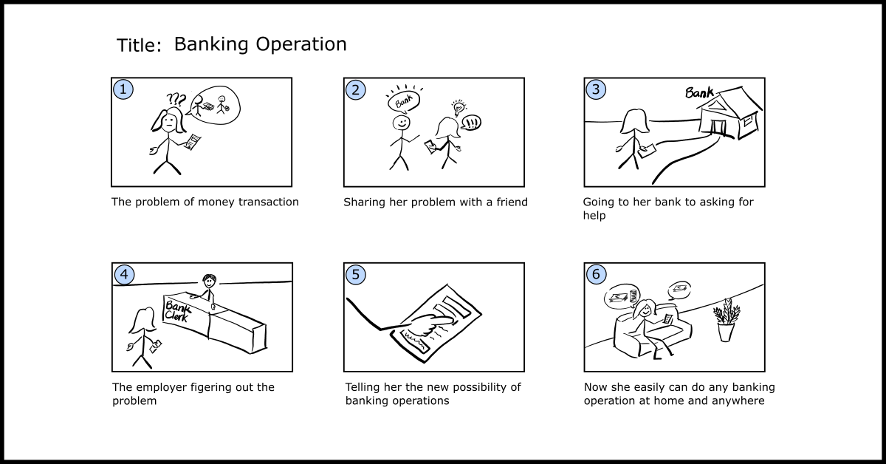
StoryBoard Usecase
https://www.freecodecamp.org/news/airpeace-website-a-ux-case-study-e0ef593f2619/
Notes:
https://www.cademix.org/storyboarding-in-ui-ux-roles-and-how-to-do-it/#:~:text=In%20UI%2FUX%20design%2C%20a,how%20people%20would%20utilize%20it.
Storyboard:
Focuses on What the user would experience
Objective is to inspire users to think, provide inputs and validate requirements
Unlike a prototype, doesn’t require technical competency to build
Look and feel is more important than what you see in a wireframe, but need not match the look and feel of a prototype
More emphasis on the users, and how different views and content come together to deliver what the user is looking for

Slide 33
Wireframes
Wireframe
A wireframe is a sketch of the system to be built. It’s simple, clear and allows everyone to read and understand easily.
Wireframe shows “just enough” information of the screen instead of the full details.
The actual screen design will be produced at a later stage by referencing the wireframe.
You can show the scenario to your customer visually to obtain consent about the requirements. They serve as a blueprint that defines each Web page’s structure or screen design, content and functionality.
Wireframes are created before any design work is started so that the focus is on layout without the distraction of color and visual elements.
https://www.freecodecamp.org/news/what-is-a-wireframe-ux-design-tutorial-website/
Notes:
https://www.freecodecamp.org/news/what-is-a-wireframe-ux-design-tutorial-website/
https://www.visual-paradigm.com/guide/ux-design/wireframe-vs-storyboard-vs-wireflow-vs-mockup-vs-prototyping/#:~:text=A%20storyboard%20is%20a%20visual,in%20the%20earlier%20development%20stage.
Wireframe:
Focuses on What the interface would resemble
Objective is to brainstorm and so wireframe need not be an exact match to end product
Contains one or more static, rough cut screenshots. Wireframe can even be an image. Look and feel is not important
It focuses more on screen layout than on functionality and navigation

Slide 34
Prototype
A prototype is a draft version of a product that allows you to explore your ideas and show the intention behind a feature or the overall design concept to users before investing time and money into development.
A prototype can be anything from paper drawings (low-fidelity) to something that allows click-through of a few pieces of content to a fully functioning site (high-fidelity).
A prototypes are computer-based, and usually allow realistic (mouse-keyboard) user interactions.
https://www.freecodecamp.org/news/ui-ux-design-tutorial-from-zero-to-hero-with-wireframe-prototype-figma/
Notes:
https://www.cademix.org/storyboarding-in-ui-ux-roles-and-how-to-do-it/#:~:text=In%20UI%2FUX%20design%2C%20a,how%20people%20would%20utilize%20it.
Prototype:
Focuses on What the end product would look and feel like
Objective is to get a sign-off prior to development
Must be built on the dashboard tool/technology of choice and so it needs technical competence
It may have data that is static and simulated
It need not be connected to a data source
The look-and-feel more or less resembles a final product than a wireframe
It should respond to user interactions
Wireframe:
Focuses on What the interface would resemble
Objective is to

Slide 35
Prototype
High-fidelity prototypes take you as close as possible to a true representation of the user interface.
High-fidelity prototypes are assumed to be much more effective in collecting true human performance data (e.g., time to complete a task), and in demonstrating actual products to clients, management, and others.
Here are the benefits of a high-fidelity prototypes:
It is much cheaper to change a product early in the development process than to make change after you develop the site. Therefore, you should consider building prototypes early in the process.
Prototyping allow you to gather feedback from users while you are still planning and designing your Web site or targeted system.
Notes:
https://www.cademix.org/storyboarding-in-ui-ux-roles-and-how-to-do-it/#:~:text=In%20UI%2FUX%20design%2C%20a,how%20people%20would%20utilize%20it.
Prototype:
Focuses on What the end product would look and feel like
Objective is to get a sign-off prior to development
Must be built on the dashboard tool/technology of choice and so it needs technical competence
It may have data that is static and simulated
It need not be connected to a data source
The look-and-feel more or less resembles a final product than a wireframe
It should respond to user interactions
Wireframe:
Focuses on What the interface would resemble
Objective is to brainstorm and so wireframe need not be an exact match to end product
Contains one or more static, rough cut screenshots. Wireframe can even be an image. Look and feel is not important
It focuses more on screen layout than on functionality and navigation
Storyboard:
Focuses on What the user would experience
Objective is to inspire users to think, provide inputs and validate requirements
Unlike a prototype, doesn’t require technical competency to build
Look and feel is more important than what you see in a wireframe, but need not match the look and feel of a prototype
More emphasis on the users, and how different views and content come together to deliver what the user is looking for

Slide 36
Test
Test is one of the most important stages in the Design Thinking process, as it is where you discover whether your idea(s) solves the user problem uncovered during the Empathise stage.
It is rare to develop a perfect solution straight away, but getting honest feedback directly from users will help to guide ongoing development whilst ensuring that their needs are met.
Notes:
https://www.cademix.org/storyboarding-in-ui-ux-roles-and-how-to-do-it/#:~:text=In%20UI%2FUX%20design%2C%20a,how%20people%20would%20utilize%20it.
Prototype:
Focuses on What the end product would look and feel like
Objective is to get a sign-off prior to development
Must be built on the dashboard tool/technology of choice and so it needs technical competence
It may have data that is static and simulated
It need not be connected to a data source
The look-and-feel more or less resembles a final product than a wireframe
It should respond to user interactions
Wireframe:
Focuses on What the interface would resemble
Objective is to brainstorm and so wireframe need not be an exact match to end product
Contains one or more static, rough cut screenshots. Wireframe can even be an image. Look and feel is not important
It focuses more on screen layout than on functionality and navigation
Storyboard:
Focuses on What the user would experience
Objective is to inspire users to think, provide inputs and validate requirements
Unlike a prototype, doesn’t require technical competency to build
Look and feel is more important than what you see in a wireframe, but need not match the look and feel of a prototype
More emphasis on the users, and how different views and content come together to deliver what the user is looking for

Slide 37
THANK YOU

